Slide 1
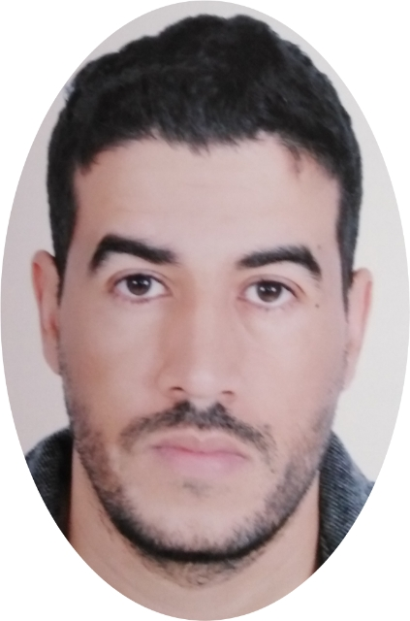
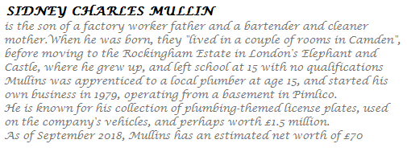
I ’m a qualified, hardworking, versatile and ambitious plumber, with more than ten years of experience in installation, repair, water treatment and pool maintenance as well as in the realization of various systems of plumbing and heating. I'm always ready to go the extra mile to provide quality work and exceed the needs and expectations of customers.
Profile Pro
2006-2007 HIGH SCHOOL LITERARY BACHELOR
2009-2010 ÉTABLISHMENT INSTITUTE OF APPLIED TECHNOLOGY MARRAKECH
Formation
OUASKAR MOHAMED
FOUNDER – OM FORYOU
2009-2011 WALLS WATER - EMPLOYEE INSTALLING, REPAIRING, MAINTAINING, SWIMMING POOLS AND PERFORMING VARIOUS PLUMBING AND HEATING SYSTEMS
2011-2014 NAOURASS ENNAKHIL - SITE MANAGER LEAD THE TEAM, COORDINATION AND SUPERVISING WORKERS, CHECKING AND PREPARING SITE REPORTS, DESIGNS AND DRAWINGS, ETC……..
2014-2019 SOURCE WATER - CO-FOUNDER PARTICIPATE IN THE ESTABLISHMENT OF THE COMPANY SEARCH FOR CUSTOMERS PLANNING FOR WORKS ETC........
2019 OM FORYOU - FOUNDER RESPONSIBILITIES INCLUDE MAKING MAJOR CORPORATE DECISIONS MANAGING THE OVERALL OPERATIONS AND RESOURCES OF A COMPANY
ADDRESSE : lot azzouzia marrakech - morocco
TEL : +212 6 78 82 90 51
E-MAIL : ps.oskar@mail.com
INSTAGRAM : @om_foryou
Contact
Experience
ENGLISH
FRENCH
Languages
CREATIVE
SERIEUX
Inspiration
Skills
OPEN
OFFICE
GOOGLE
ADWORDS

