Slide 1

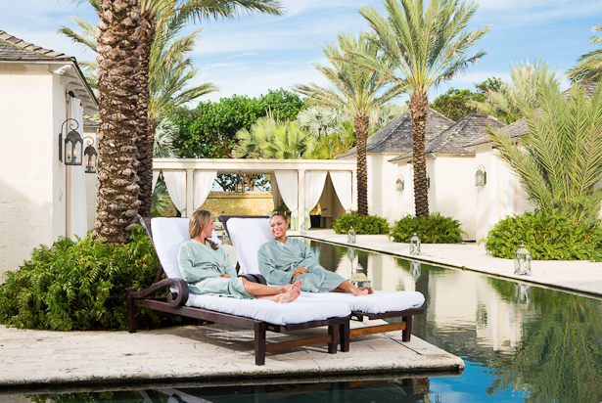
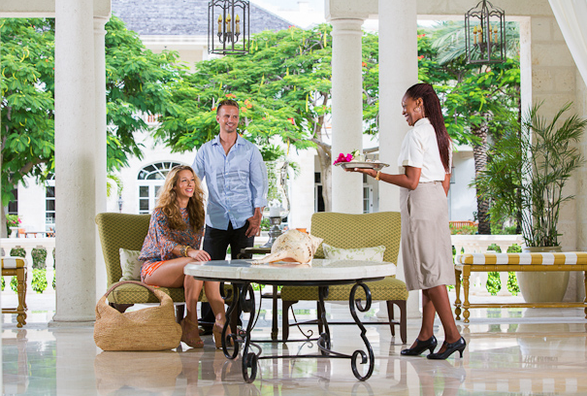
Public Relations & Marketing Overview 2013-2014

Slide 2
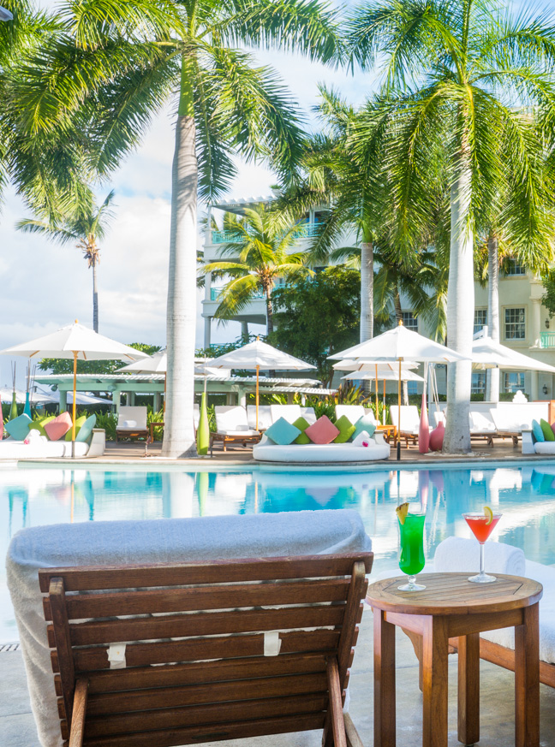
PUBLIC RELATIONS
Since January, 2013, JPR has secured over 100
media placements, several dozen media visits, and
a correlating advertising value of over $15 million.
Regent Palms received ink in
coveted outlets such as:
The New York Times
Forbes.com
Wall Street Journal
Modern Luxury
Travel + Leisure
CNN Travel
The Dallas Morning News
Atlanta Journal Constitution
Incentive, Virtuoso Life, Meetings Focus, American Spa
and Simply Buckhead.
Held Media Missions and Deskside Chats in New York, Dallas,
San Diego, and Brazil.

Slide 3


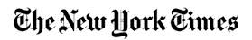



GETTING PICKED UP
$15.39 Million in PR/AD Value
Circulation: 100,000
Circulation: 250,000
Circulation: 1. 9 million
Circulation: 971,922
Circulation: 43,000
UMV: 50 million
Circulation: 12,000

Slide 4
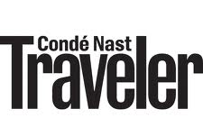




GETTING PICKED UP
105 print and digital media placements
12.47 million total print circulation
231.44 million total online monthly visitors
Circulation: 240,000
UMV: 200,000
UMV: 404,000
Circulation: 38,000
Circulation: 130,000
UMV: 26 million

Slide 5
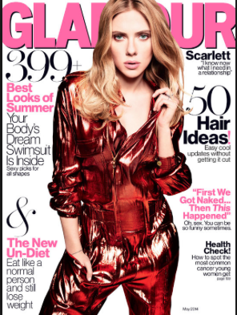
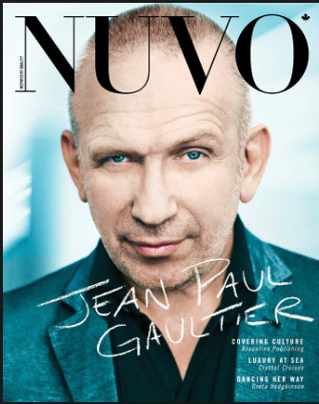

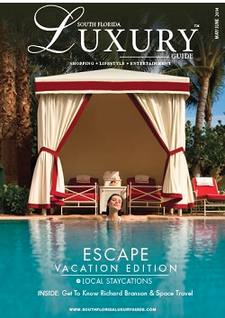
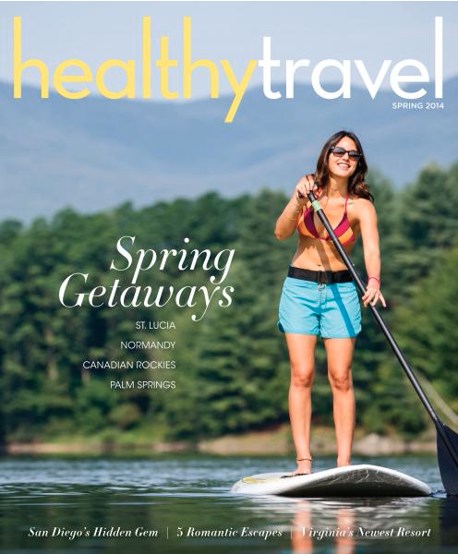

UPCOMING STORIES

Slide 6
AWARDS & ACCOLADES
(just to name a few)
2014 Luxury Travel Advisor Top General Manager Worldwide
2014 Conde’ Nast Johansen “Best Hotel Spa”
2014 Celebrated Living Platinum Award Nomination
2014 Virtuoso Spa Nomination
2014 LEADERS MAGAZINE World’s Leading Suites
2013 Conde’ Nast Traveler Gold List
2013 T+L 500 Best Hotels in the World/ #1 in Turks and Caicos
2013 Conde’ Nast Traveler Top Spa in the Caribbean
2013 March - Regent Palms accepted into Virtuoso
2013 World Travel Awards Turks & Caicos Leading Spa Resort
2013 World Travel Awards Caribbean Leading Spa Resort
2013 World Travel Awards Worlds Leading Spa Resort
2013 Star Awards’ Hotel of the Year
2013 Star Awards’ Hotelier of the Year
2013 LEADERS MAGAZINE World’s Leading Suites
2013 Travel Weekly Magellan Award, Luxury Spa Design

Slide 7
PRESS TRIPS
30+ media on property in 2013 and 2014
Five press trips
Washington Post
Simply Buckhead
Recommend
Fitness
New York Resident
New York Post
Northstar Media
Lucky Magazine
Destination Weddings & Honeymoons
Modern Luxury
South Florida Luxury Guide
Healthy Travel Magazine
The Globe and Mail
Nuvo
JetSet Magazine
Bella NYC
Los Angeles Times
Up! WestJet’s in-flight
Dallas Morning News
Denver Reign magazine
Travel Weekly
Hotel-Online
MeetingsNet
Details
Glamour
SCENE Magazine
Islands
Bridal Guide

Slide 8
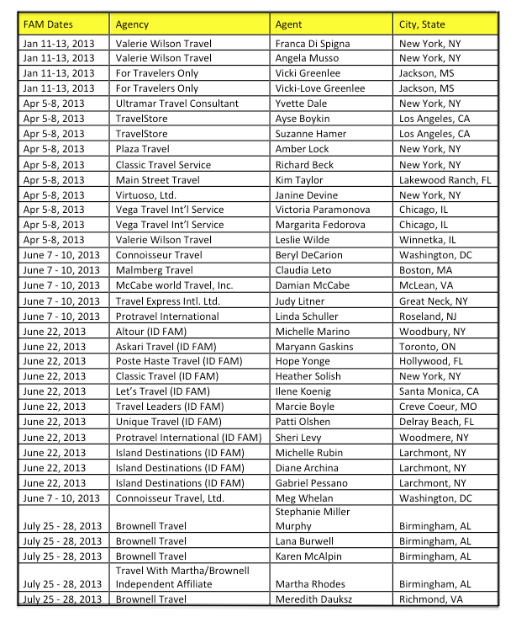
2013 TRAVEL PARTNER FAM TRIPS
.

Slide 9
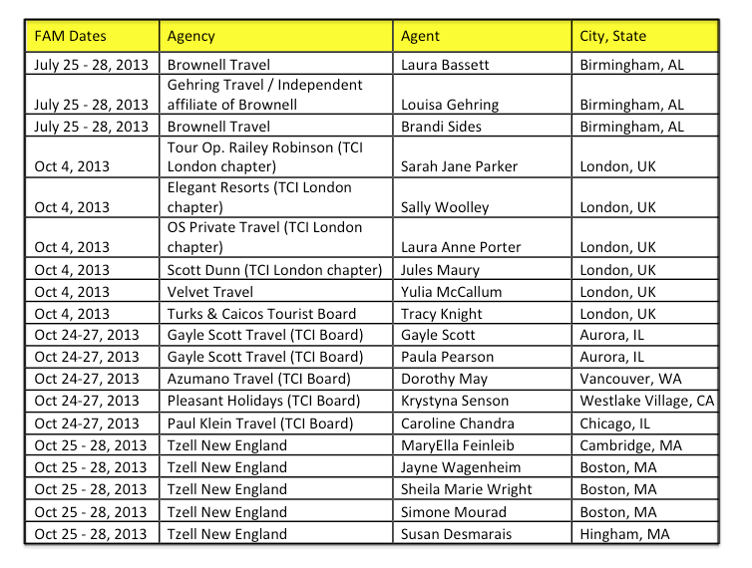
2013 TRAVEL AGENT PARTNER TRIPS

Slide 10
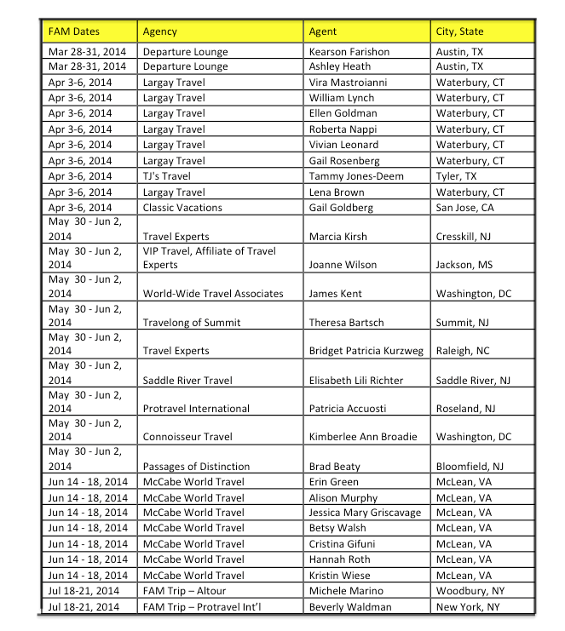
2014 TRAVEL AGENT PARTNER TRIPS

Slide 11
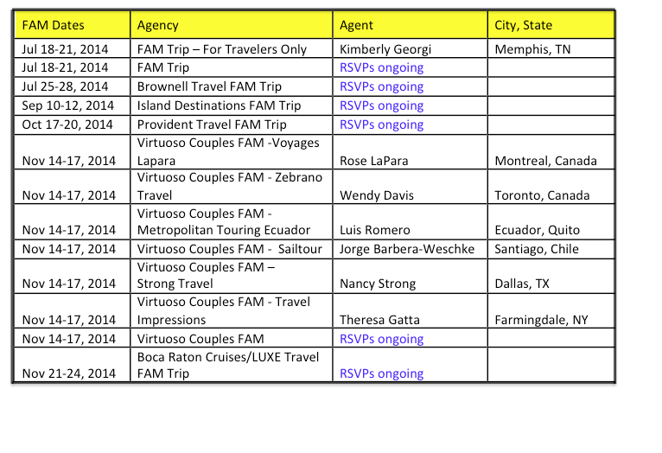
2014 TRAVEL AGENT PARTNER TRIPS

Slide 12
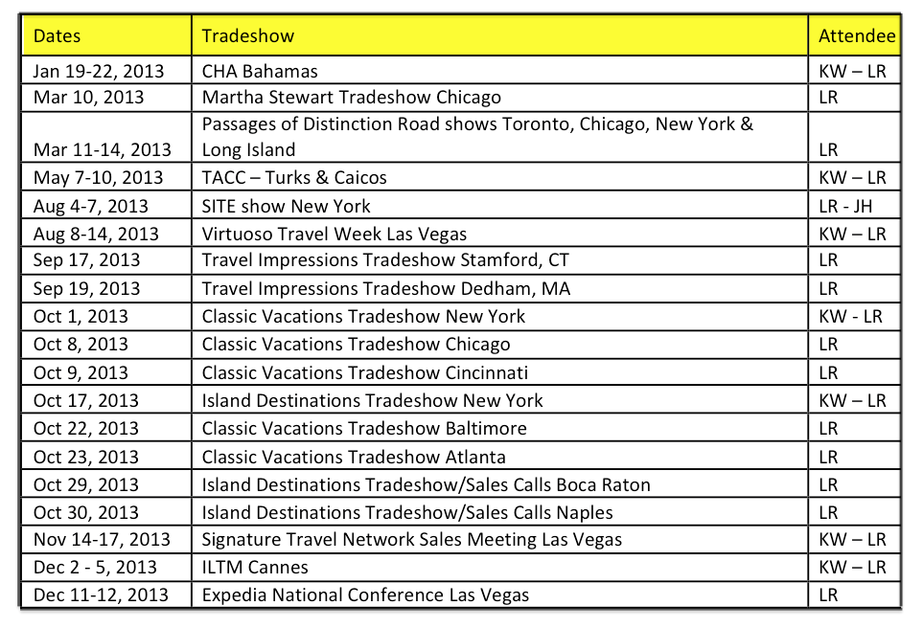
2013 TRAVEL PARTNER TRADESHOWS

Slide 13
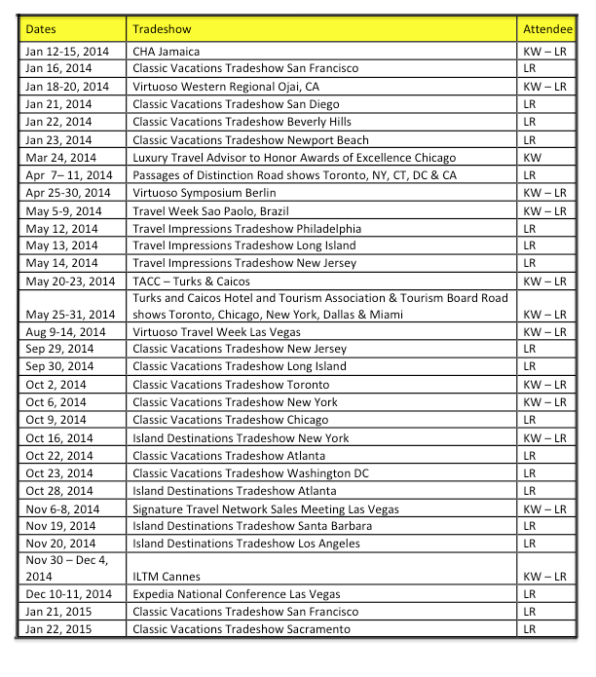
2014 TRAVEL PARTNER TRADESHOWS

Slide 14
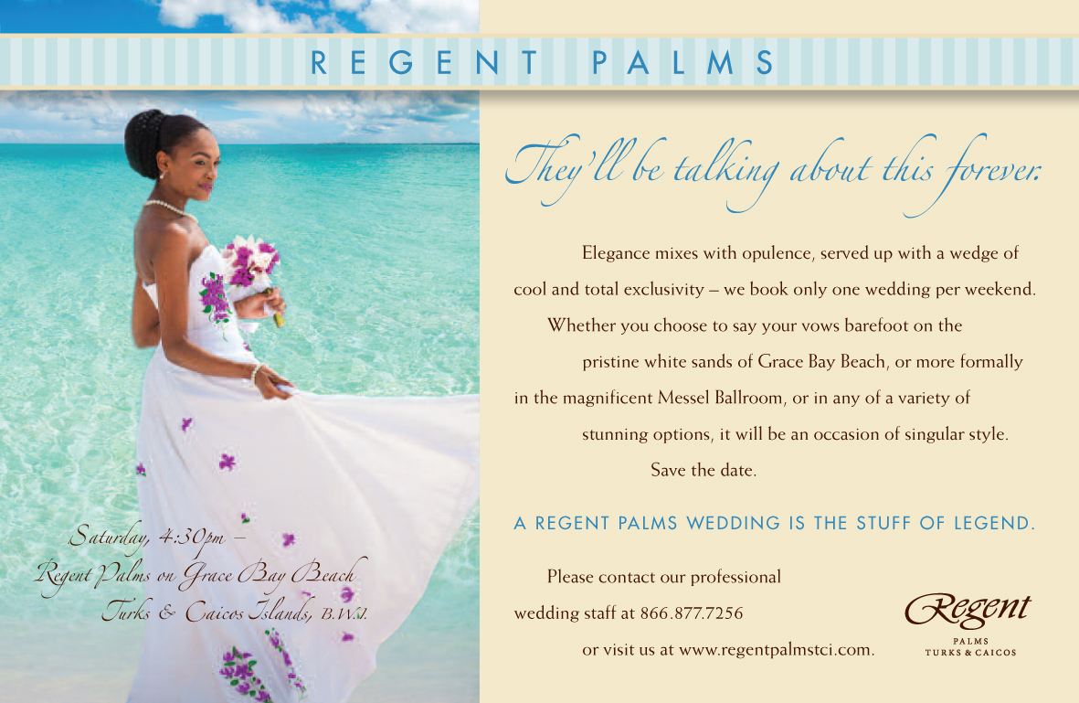
FOCUS ON WEDDINGS AND GROUPS

Slide 15
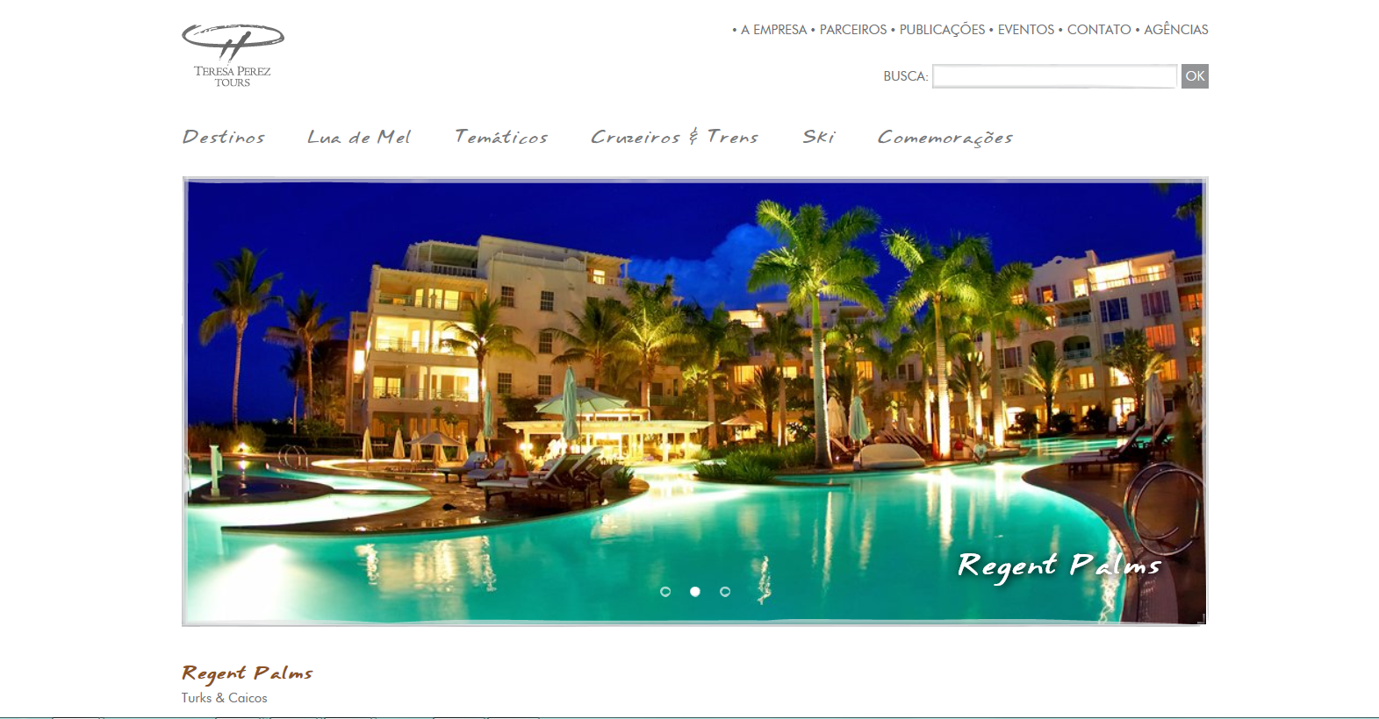
BRAZIL AND SOUTH AMERICA
Featured in top travel partner programs
Travel Week South America

Slide 16
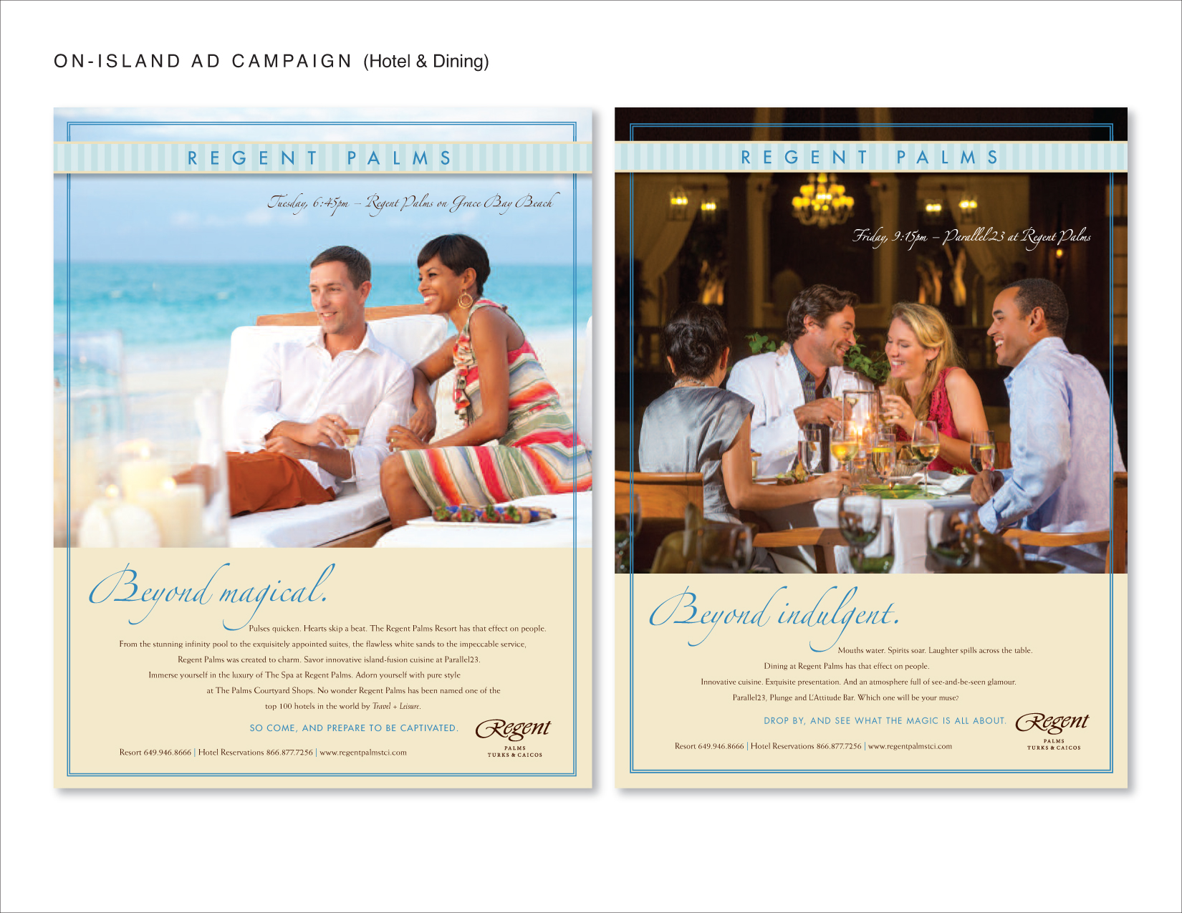

Slide 17
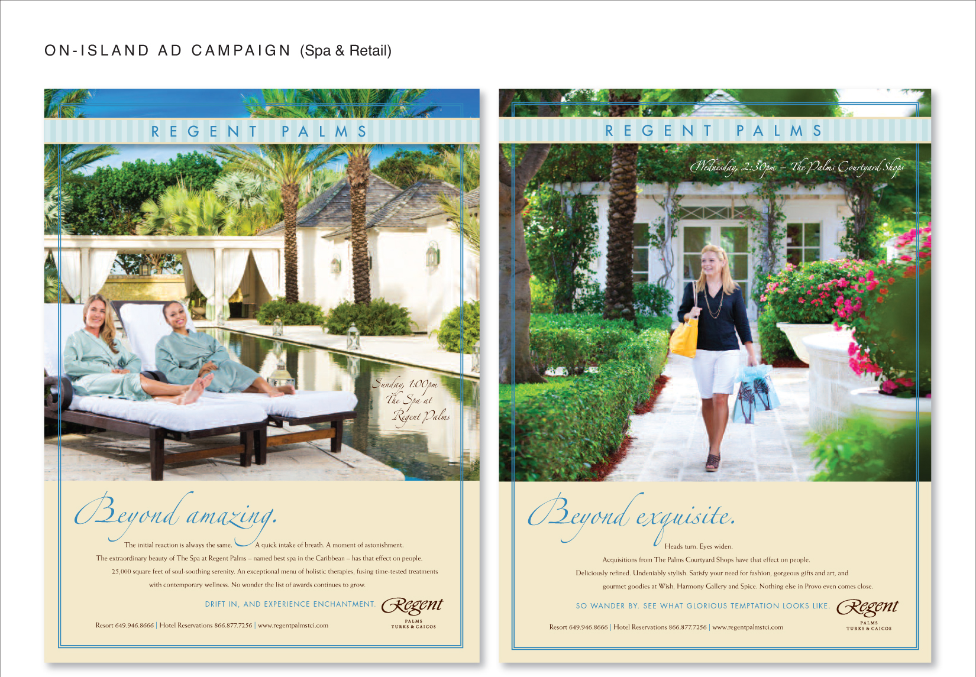

Slide 18
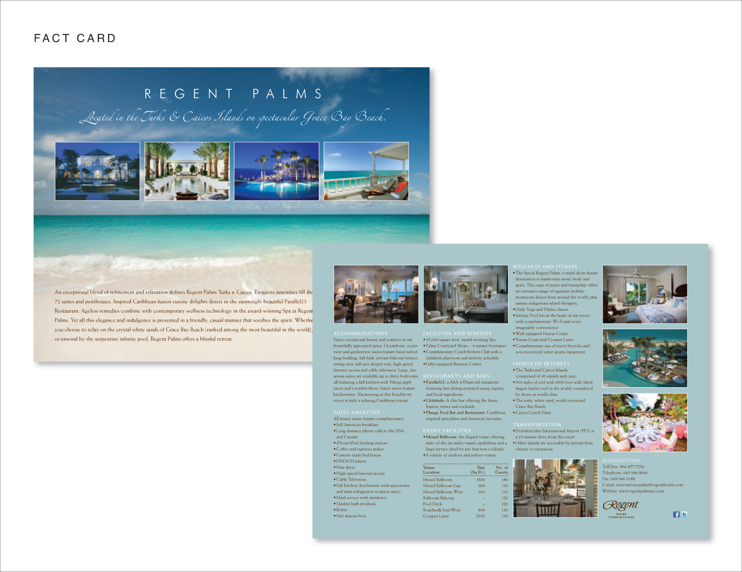

Slide 19
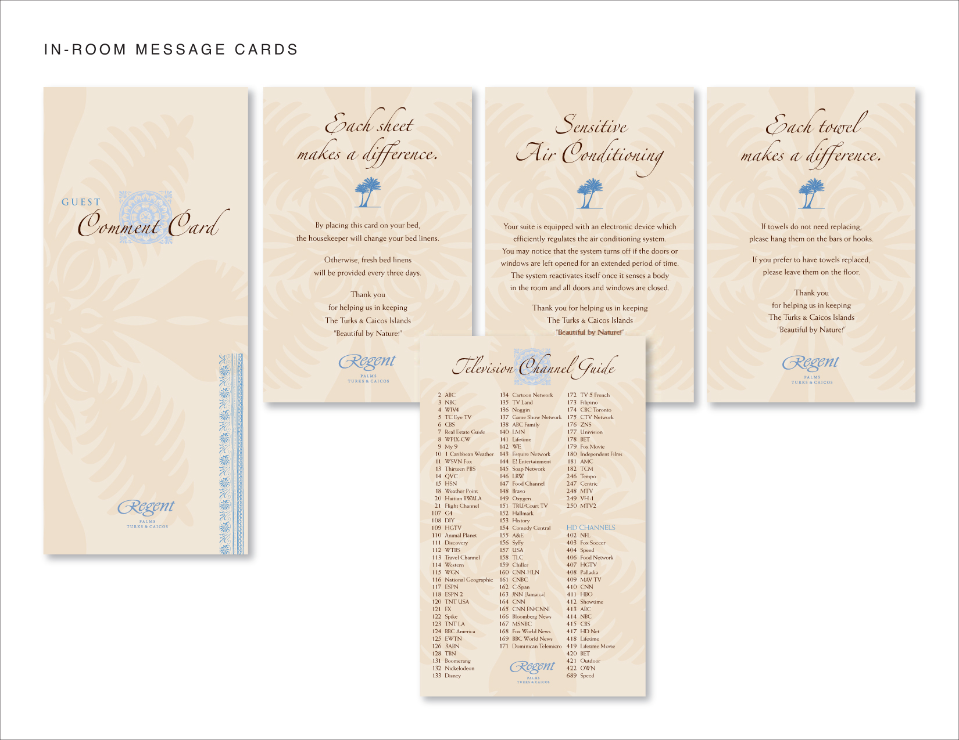

Slide 20
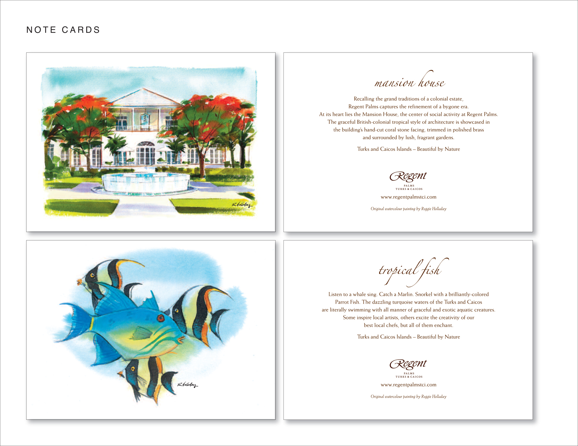

Slide 21
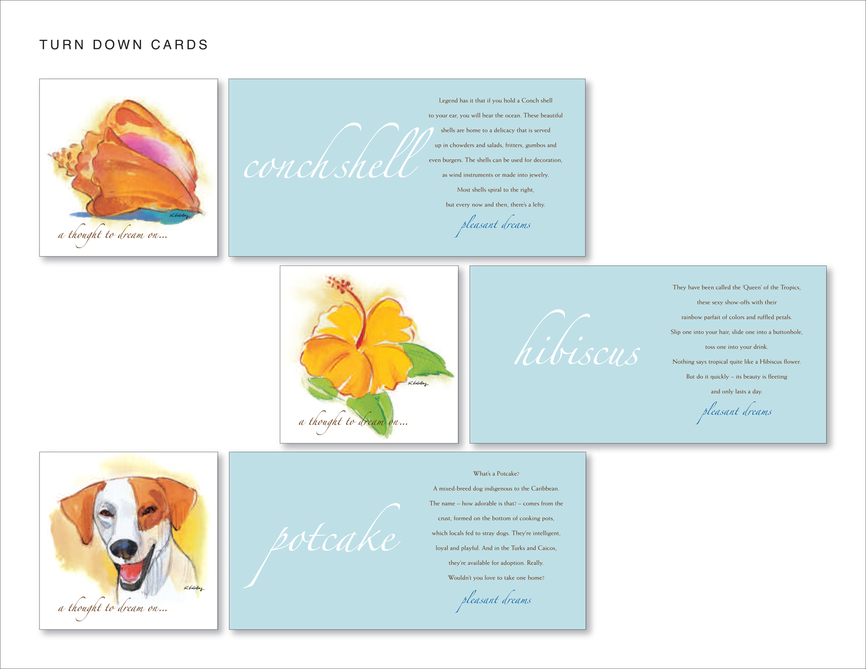

Slide 22
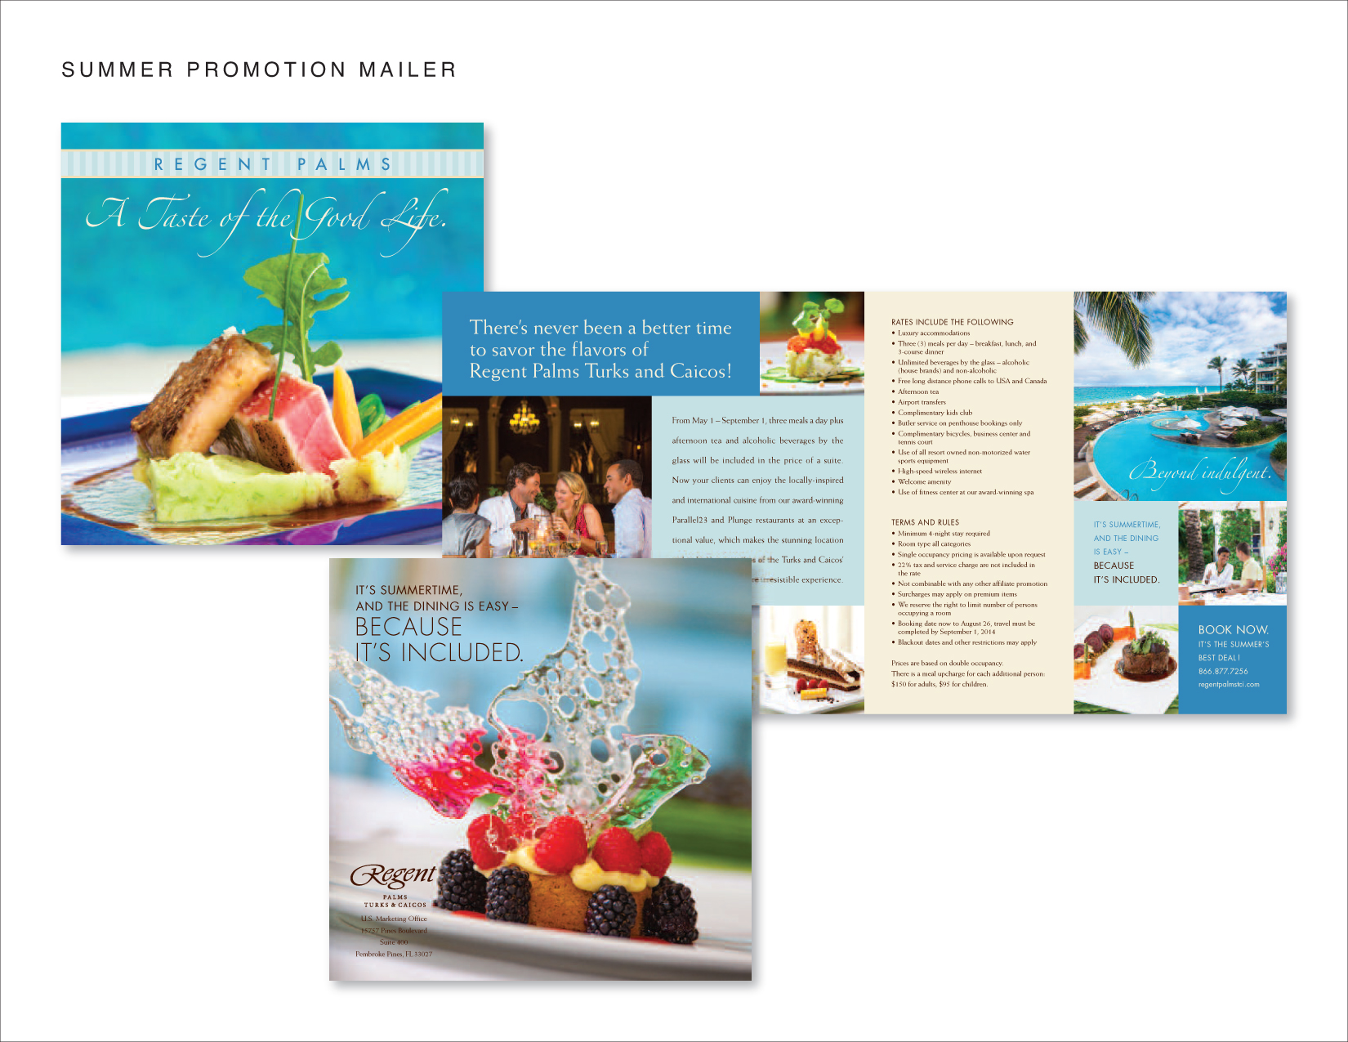

Slide 23
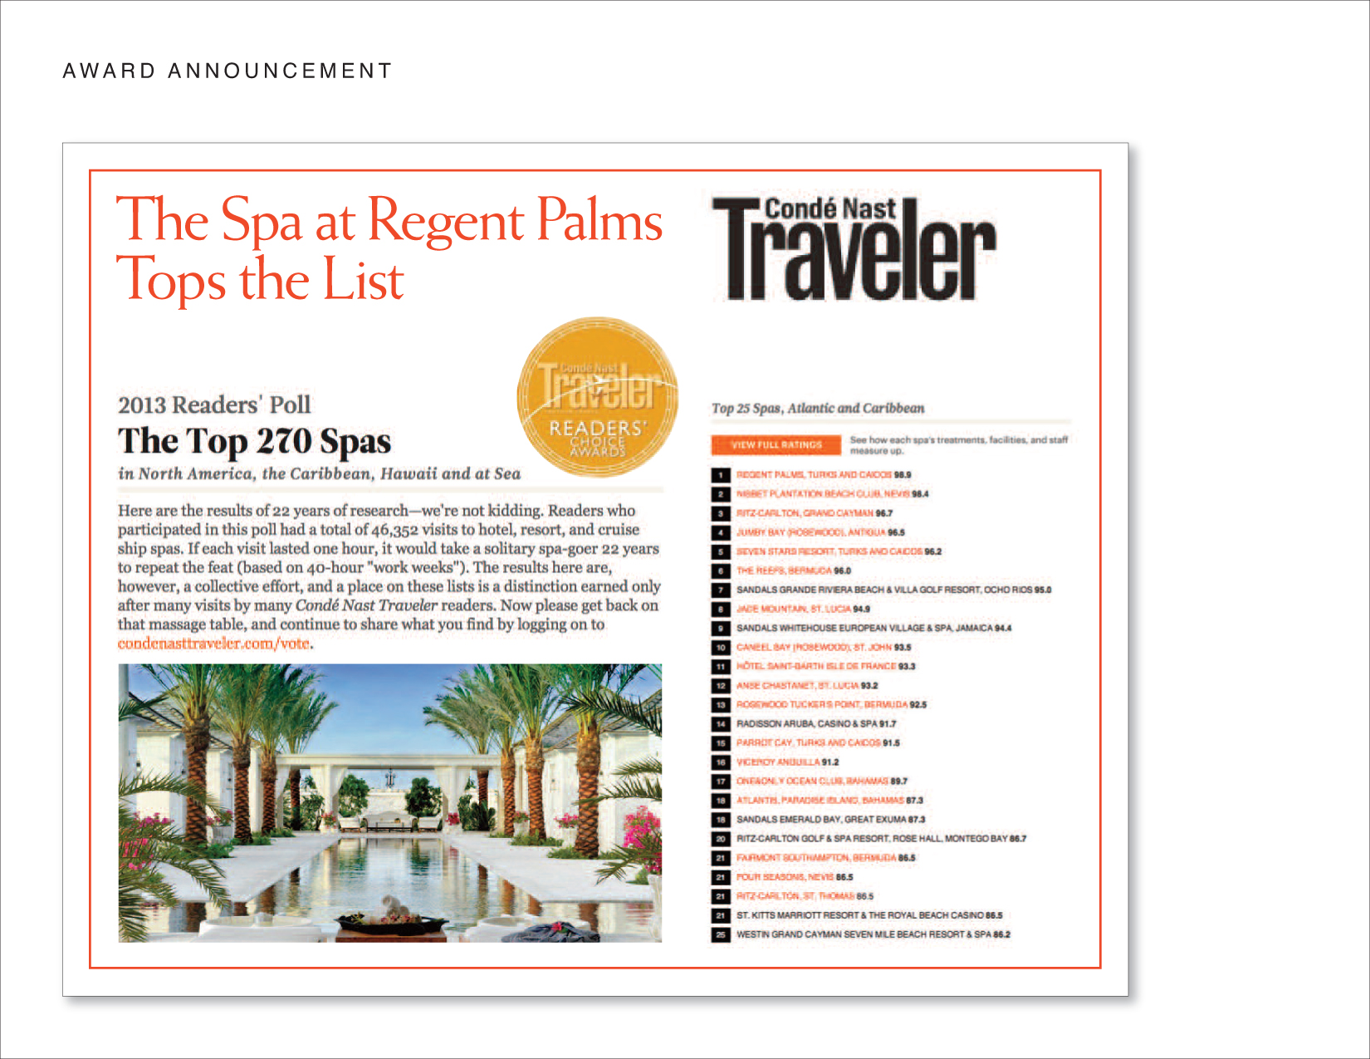

Slide 24
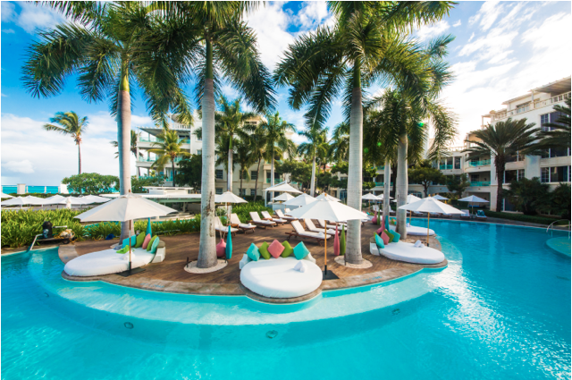
Thank You!

