Slide 1

Brand Guide
2230718
.
© 2023 EquInox Business Law Group

Slide 2
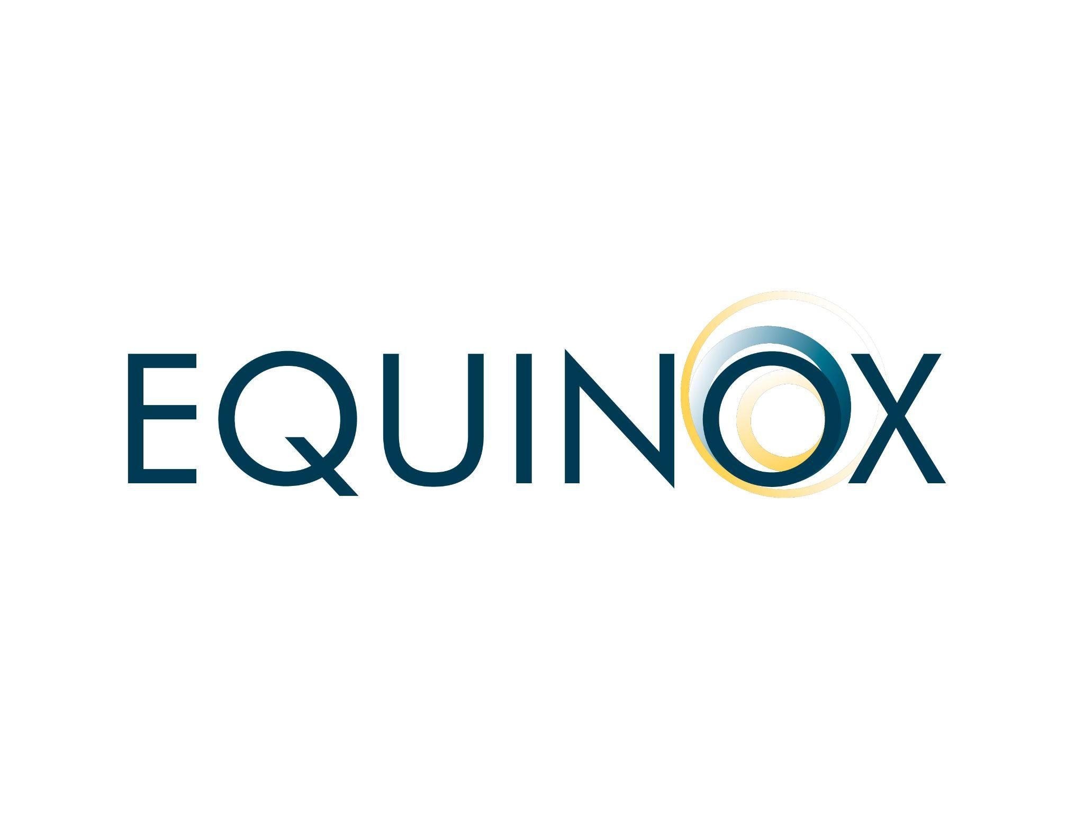
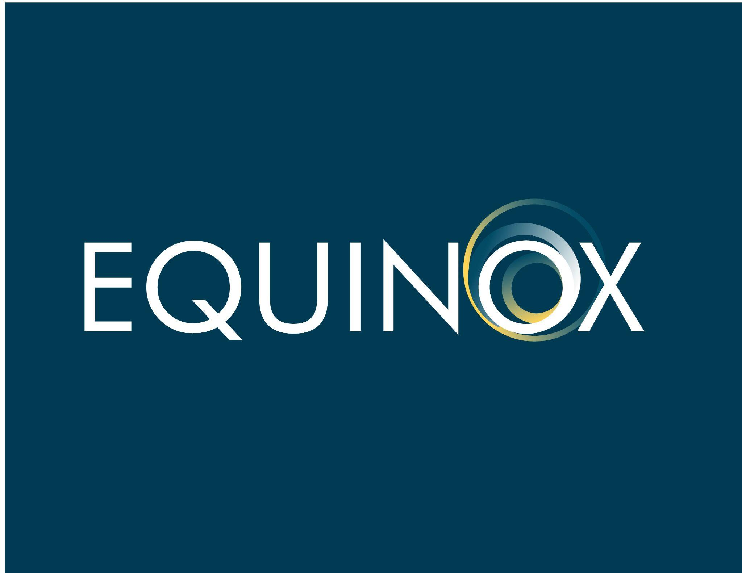




LOGO
Our logo represents our brand promise law and entrepreneurial experience, perfectly aligned.
The “swirl” of day and night becoming one together is how we become one team with our clients with equal parts law and business.
Balance and equity is in our namesake: the “equinox”, time (twice each year) when day and night are of approximately equal length as the sun crosses the celestial equator (about September 22 and March 20).
In use, our logo shows up with and without the tagline. It should be on white or bright brand gradient backgrounds to best convey the bold confidence we empower.

Slide 3
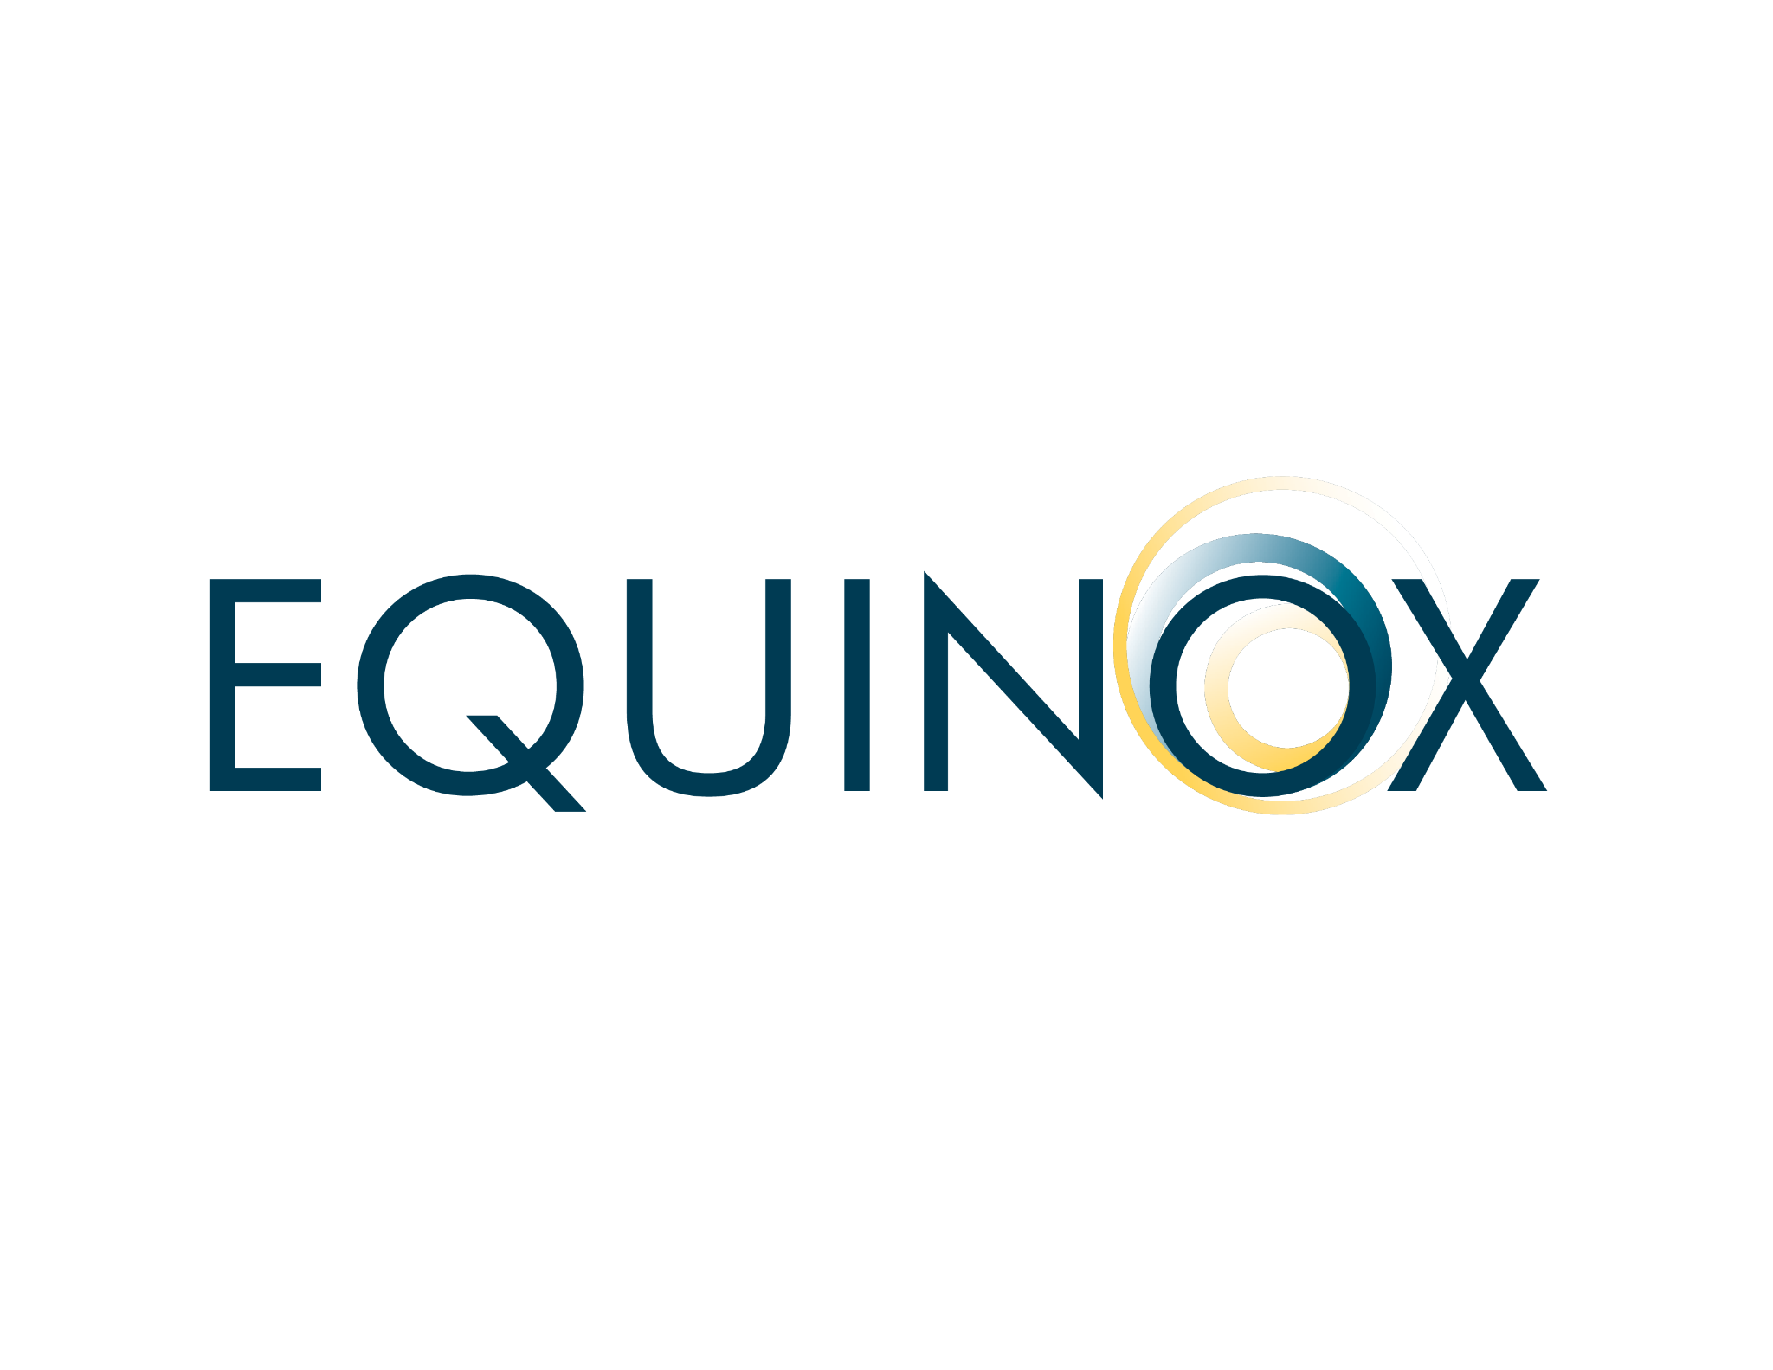

LOGO
WORDMARK
WORDMARK WITH TAGLINE

Slide 4
LOGO
WORDMARK REVERSE
WORDMARK WITH TAGLINE REVERSE

Slide 5


LOGO
SWIRL MARK
SWIRL MARK REVERSE

Slide 6
COLOR
CONCEPT
Our colors are designed to convey the feeling of confidence and freedom that result from brand’s promise of law and entrepreneurial experience, perfectly aligned.
We use of color in alignment and in contrast to represent our alignment of law and business as well as the alignment as one team with our clients.
We use gradients to show the two colors becoming one.
BRIGHT YELLOW = LAW
BRIGHT BLUE = BUSINESS
YELLOW = CONFIDENCE
BLUE = FREEDOM
DARK YELLOW = DAY
DARK BLUE = NIGHT

Slide 7
COLORS
DAY
CONFIDENCE
LAW
NIGHT
BUSINESS
FREEDOM
HEX
RGB
HSB
CMYK
LAB
PANTONE
#D98D00
217, 141, 0
39, 100, 85
0, 35, 100, 15
65, 20, 70
131 C
HEX
RGB
HSB
CMYK
LAB
PANTONE
#FFD457
255, 212, 87
0, 0, 73
0, 17, 66, 0
87, 2, 65
135 C
HEX
RGB
HSB
CMYK
LAB
PANTONE
#FFFAEB
255, 250, 235
45, 8, 100
0, 2, 8, 0
98, -1, 8
155 C
HEX
RGB
HSB
CMYK
LAB
PANTONE
#003b53ff
0, 59, 83
197, 100, 33
100, 29, 0, 67
23, -7, -19
540 C
HEX
RGB
HSB
CMYK
LAB
PANTONE
#027CA1
2, 124, 161
194, 99, 63
99, 23. 0, 37
48, -15, -28
7704 C
HEX
RGB
HSB
CMYK
LAB
PANTONE
#93BCCD
147, 188, 205
198, 28, 80
28, 8, 0, 20
74, -10, -13
283 C

Slide 8
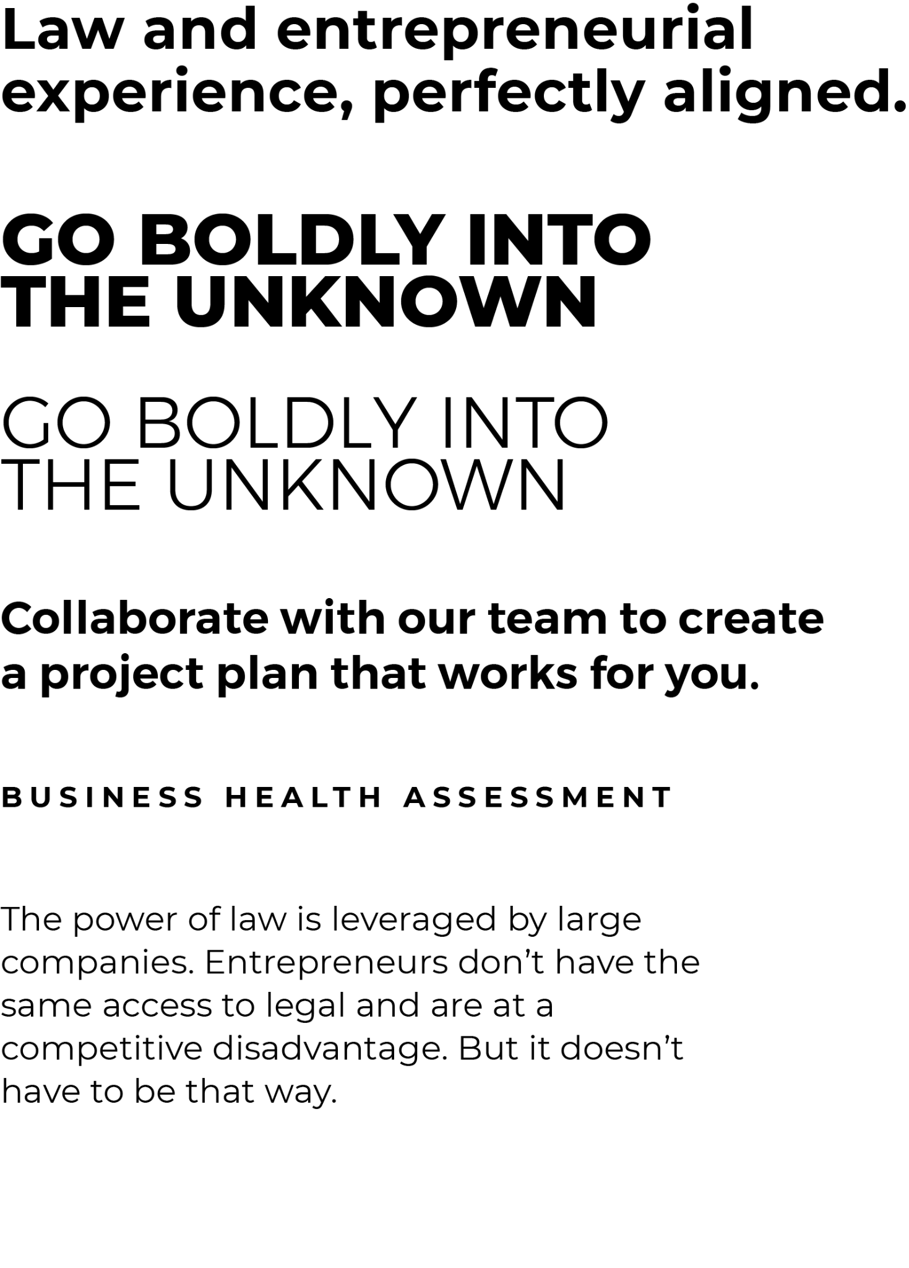
FONTS
HEADLINES H1
Montserrat Bold
Sentence Case
Line Height 1.1
Tracking +5
HEADLINES SHORT H2
Montserrat ExtraBold
All Caps
Line Height .08
Tracking 0
HEADLINES SHORT H3
Montserrat Light
All Caps
Line Height .08
Tracking 0
SUB HEADLINES H4
Montserrat SemiBold
Sentence Case
Line Height 1.3
Tracking +5
CALLOUTS
Montserrat Bold
All Caps
Line Height 1
Tracking +250
BODY
Montserrat Regular
Sentence Case
Line Height 1.2
Tracking +5

