Slide 1

Brand Guide
220624
.
© 2022 EquInox Business Law Group

Slide 2
Brand Guide
220624
.
© 2022 EquInox Business Law Group

Slide 3
GUIDE
CONTENTS
03
10
11
17
23
26
29
37
47
59
MATTERFESTO
OUR FOUNDATION
PROMISE
POSITION
NARRATIVE
PERSONALITY
BRAND BRICKS
STORY
DESIGN
BLUE PRINTS
These guidelines are mandatory and must be applied consistently and rigorously to all creative assets made on behalf of Equinox.
The information contained in this document is highly confidential and is the proprietary business information of Equinox Business Law Group. It may not be disclosed, reproduced or used for any purposes other than the fulfillment of the business objectives of Equinox. You are obligated to protect this information from unauthorized use or disclosure.
.
© 2022 EquInox Business Law Group

Slide 4


MATTERFESTO

Slide 5

MATTER
FESTO
BRAND BELIEF
We believe in the power of law to enable the freedom and confidence to go boldly into the unknown.

Slide 6
MATTER
FESTO
OUR PEOPLE
Entrepreneur leaders with a growth mindset who leverage fractional services for expertise and growth, but not for legal.

Slide 7
MATTER
FESTO
CURRENT STATE/PROBLEM
Entrepreneurs don’t trust that lawyers can be affordable, accessible, or a strategic advantage. Law feels like a complicated cost that only mega corps can afford.
So they go at it alone.

Slide 8
MATTER
FESTO
FUTURE STATE/PROMISE
We imagine a world where entrepreneurs have the same strategic law advantages as the mega corps.

Slide 9
MATTER
FESTO
HOW WE MAKE IT HAPPEN
We make it possible for all business leaders to have a “Chief Legal Officer” on their team by removing the barriers of costs, response time, and complexity.

Slide 10
MATTER
FESTO
BRAND BELIEF
The essence of what matters to us and our customer. The shared values and raison d être.
We believe in the power of law to enable the freedom and confidence
to go boldly into the unknown.
OUR PEOPLE
The hero of your brand narrative, the customers we help.
Entrepreneur leaders with a growth mindset who leverage fractional
services for expertise and growth, but not for legal.
CURRENT STATE/PROBLEM
What is the real-real
problem we solve?
Entrepreneurs don’t trust that lawyers can be affordable, accessible, or a strategic advantage. Law feels like a complicated cost that only mega corps
can afford. So they go at it alone.
FUTURE STATE/PROMISE
What’s our vision? The transformational change that we deliver.
We imagine a world where entrepreneurs have the same
strategic law advantages as the mega corps.
HOW WE MAKE IT HAPPEN
The way we lead, help, and guide with passion and expertise in product or service.
We make it possible for all business leaders to have a “Chief Legal Officer”
on their team by removing the barriers of costs, response time, and complexity.

Slide 11

FOUNDATION

Slide 12
We enable entrepreneurs with the same strategic law advantages as the mega corps.
FUTURE STATE/PROMISE

Slide 13


EQUINOX TEAM VALUES
Equinox Team Members
We are legal professionals with real business experience as in-house counsel, business degrees, or entrepreneurs. We are:
Business First
We understand business and support the leadership team’s vision and strategy to achieve its goals.
Deal Makers
We work collaboratively and innovatively to move the business forward, advising on the balance of business and law in each decision.
Intentional
We follow through on our commitments.

Slide 14

FOUNDATION
FUTURE STATE/PROMISE
We enable entrepreneurs with the same strategic law advantages as the mega corps.
KNOWLEDGE
CONNECTED
EMPATHETIC
CONFIDENCE
We are strategic-minded business leaders and lawyers who are savvy in law and business challenges.
We work as as an extension of our clients’ C-suite to seamlessly support both the strategic and tactical legal needs.
.
Legal expertise and service by and for business leaders–with compassion and humanity.
Our clients feel empowered with the same strategic law advantages as large organizations.
VISION
CERTAINTY
EFFICACIOUS
FREEDOM
We see the law through the lens of an entrepreneur to proactively navigate legal risks and opportunities.
Our clients know exactly what their investment is; we deliver predictable cost with expected outcomes.
We are reliable, responsive, and effective experts who deliver outcomes that make an impact.
Our clients feel free to boldly go into the unknown–to innovate and grow their business.
FOUNDATIONAL
DIFFERENTIATION
EXECUTION
OUTCOME
What we offer to
engage our customer
What makes our
offering unique
How we deliver our
offering to our customers
The emotional outcome
when we deliver on our
Brand Promise
Notes:
Extension of the team, available to support both the strategic and tactical needs every day.
“Partnering with Equinox has changed the way we do business. I know that I have a strategic business partner that will help us make good decisions that are based in business-reality.”
Because we know your business, we can provide quick, relevant and valuable counsel
I trust them, so I don't even need to read it. -- J Scott comment
I know your business, I understand your business, I know how you think about your business and your risk tolerance, so I can provide counsel that works for you, that you can trust
We know your business, so it's seamless to include us in the strategic and tactical decisions you need to make everyday.

Slide 15
FOUNDATION
FOUNDATIONAL
What we offer to
engage our customer
What does “Knowledge” mean at Equinox?
We are strategic-minded business leaders and lawyers who are savvy in law and business challenges.
Why “Knowledge” matters to our business…
Knowing first-hand the complexities entrepreneurs face gives us empathy and a clear vision of both the risks and the opportunities.
When we get it right…
Our clients trust us, and include us in their inner c-cuite circle because they know we understand their business’ real-real needs.
What does “Vision” mean at Equinox?
Seeing the whole picture through entrepreneur business and proactive law lenses to deliver strategically and tactically.
Why “Vision” matters to our business…
We are looking out for our clients. We look ahead not just behind. We enable the freedom and confidence for our clients to go boldly into the unknown.
When we get it right…
Clients go from using law reactively to cover risk, and move into exercising proactive law to uncover new markets and opportunities they never thought possible.
KNOWLEDGE
We are strategic-minded business leaders and lawyers who are savvy in law and business challenges.
VISION
We see the law through the lens of an entrepreneur to proactively navigate legal risks and opportunities.

Slide 16
FOUNDATION
DIFFERENTIATION
What makes our
offering unique
What does “Connected” mean at Equinox?
We work as as an extension of our clients’ C-suite to seamlessly support both the strategic and tactical legal needs.
Why “Connected” matters to our business…
Working as an extension of our client’s team helps us understand their needs and better help them resulting in significantly less time invested in transactional legal with a law firm.
When we get it right…
Our clients call on us for strategic planning instead of crisis management. And they continue to call, as we develop a mutual, long term and profitable relationship.
What does “Certainty” mean at Equinox?
Our clients know exactly what their investment is; we deliver predictable cost with expected outcomes.
Why “Certainty” matters to our business…
We offer “Chief Legal Counsel” at a fixed cost so there’s no uncertainty or lack of trust in using our service. There’s also certainty that we will get it right because we’re part of the team and the conversation.
When we get it right…
When our client’s trust us with their strategic conversations, delegate and add more scope to our team.
CONNECTED
We work as as an extension of our clients’ C-suite to seamlessly support both the strategic and tactical legal needs.
CERTAINTY
Our clients know exactly what their investments is; we deliver predictable cost with expected outcomes.

Slide 17
FOUNDATION
EXECUTION
How we deliver our
offering to our customers
What does “Empathetic” mean at Equinox?
We listened first to understand the person as well as the problem before we go into solution mode.
Why “Empathetic” matters to our business…
We put people first, and truly act as if we are part of our client’s C-Suite wearing both our entrepreneur and lawyer hats.
When we get it right…
We develop long term and meaningful relationships with our clients that grow as we help their businesses grow.
What does “Efficacious” mean at Equinox?
We boldly go. We have a bias for taking action and doing what’s right to deliver a dependable experience every time.
Why “Efficacious” matters to our business…
Fortune favors the bold. We get stuff done. Straight-talk, no BS or pretention. We are driven to lead the industry in customer trust, knowledge, and effectiveness.
When we get it right…
Clients know they can count on us. We bring confidence, experience, and leadership to solve complicated problems.
EMPATHETIC
Legal expertise and service by and for business leaders–with compassion and humanity.
EFFICACIOUS
We are reliable, responsive, and effective leaders who deliver outcomes that make an impact.

Slide 18
FOUNDATION
OUTCOME
The emotional outcome
when we deliver on our Brand Promise
What does “Confidence” mean at Equinox?
Although we lead with confidence, it’s not about us. We do empower our clients to “know what they don’t know” so they can confidently make good decisions.
Why “Confidence” matters to our business…
Distrust is the industry norm for attorneys. We build trust by removing the barriers of unknown costs, response time, and business complexity.
When we get it right…
Our clients remain proactive and growth-minded. They keep us near and dear as they fearlessly take on the status quo.
What does “Freedom” mean at Equinox?
Our clients feel free to boldly go into the unknown–to innovate and grow their business.
Why “Freedom” matters to our business…
We believe that every business should and can have a “Chief Legal Officer” on their team. And when they do, they use same legal advantages of large organizations to compete and win.
When we get it right…
Our clients feel like they can grow and innovate their business–which in turn, allows Equinox to grow and innovate our business.
CONFIDENCE
Our clients feel empowered with the same strategic law advantages as large organizations.
FREEDOM
Our clients feel free to boldly go into the unknown–to innovate and grow their business.

Slide 19

OUR POSITION
We don’t compete in contested red markets of business law as usual. Instead, we forge our own path to into the unknown.

Slide 20
Strategic Legal Counsel For All
FUTURE STATE/PROMISE

Slide 21

NEIGHBORHOOD
FROM
TO
“what we do”
positional tagline
“why we matter”
positional tagline

Slide 22
NEIGHBORHOOD
THIS
NOT THIS
Strategic Legal Counsel For All
Strategic Legal Counsel For Small Businesses
Strategic Legal Counsel For Entrepreneurs
Legal Counsel For Entrepreneurs
Strategic Legal Counsel
General Legal Counsel
Fixed Cost, Strategic Legal Counsel For Entrepreneurs
Fractional Legal Counsel For Entrepreneurs

Slide 23

NEIGHBORHOOD
Strategic Business Consultancies
FTE, In-House
Managed Services Providers
General Counsel Business Law

Slide 24

ADJACENCIES
LIVE
LEARN
BUY
Spaces and places where our customers go in real life.
Where our customers go for knowledge, to search for personal and professional growth.
Where and how our customers consume other services in the growth of their business.
Food: Wholefoods, Specialty Foods, Farmers Markets
Health: Gym member, Personal Trainer, Peloton
Family: Child Care & Pet Care Services
Second Space: Coffee Shops, WeWork, Knack Workspaces, Galvanize Seattle
Drink: Local Wine Bars, Distilleries and Breweries.
Entertainment: Netflix, Hulu, Amazon, Pandora, Spotify
Google Search: Top Law Firms, Seattle Business Law
Podcasts: The Shrimp Tank, The Tim Ferriss Show, TEDTalks, $100 MBA
Business Publications: Puget Sound Business Journal, HBR, Fast Company, Bloomberg
LinkedIn: Professional Groups - EO Seattle, Vistage Seattle, WPO, Seattle Good Business Network, Seattle SBA, Greater Seattle VCs & Entrepreneurs
Fractional, Managed Services: Trinet, HCL Technologies, Cognizant, Zenefits, ADP
SAAS: Intuit, Shopify, Hubspot, Salesforce, Microsoft, Google Workspace
Out-source: Freelance marketplaces; UpWork, TopTal, LinkedIn
Wholesale/Bulk: Costco, Amazon, Alibaba
Business Banking: Umpqua Bank, WaFd Bank, Key Bank, Seattle Credit Union

Slide 25

OUR NARRATIVE

Slide 26

NARRATIVE
SUCCESS
MEETS A GUIDE
AND CALLS THEM TO ACTION
Equinox is a group of strategic business leaders and lawyers who:
1. Know what you don't know
2. Wield the power of law to enable the freedom and confidence to go boldly into the unknown.
Go boldly into the unknown.
Take the assessment. Get paired with a “Chief Legal Officer” to help you navigate what’s ahead.
Empowered with the same strategic law advantages as the large organizations.
Navigate the unknown to uncover new strategic opportunities and growth.
A CHARACTER
An entrepreneur leader with a growth mindset who currently uses other fractional services
?
FAILURE
THAT RESULTS IN…
WITH A PROBLEM
Fear of the unknown slows or paralyzes innovation because they don’t know what they don’t know about legal issues.
Don’t think they can afford to have an attorney on their team so they try to DIY.
Remain reactive and paralyzed by risks of unknown costs, response time, and business complexity.
Going blindly or alone into the unknown.
WHO GIVES THEM A PLAN
Remove the barriers of costs, response time, and complexity so that all business leaders can have a “Chief Legal Officer” on their team not their payroll.
Daniel
Learn Karate
Gets bullied, Cobra Kai dojo bullies win
Getting ass kicked by bullies
Notes:
Be a generalist across business law topics. The industry has tuned businesses to believe that they need a “specialist” for each part of their business – but a general counsel is a generalist, able to connect the dots across the different parts of your business and provide continuity in your strategy and operations. It’s also important for cost savings and efficiency and understands the full picture.
Your business deserves to have legal a part of its team because strategic counsel is essential for a secure and successful future. Most entrepreneurs would say this kind of legal service doesn't exist -- but it does. You just have to look hard -- and then demand a relationship that aligns your needs with theirs. The legal industry is changing to recognize that customers have alternatives and they need to catch up. It’s slow but it’s out there.

Slide 27
NARRATIVE
The Pitch Story
CHARACTER
Small business leader with a growth mindset who currently use other fractional services
PROBLEM
Fear of the unknown slows or paralyzes innovation because they don’t know what they don’t know about legal issues
Don’t think they can not afford to have a “Chief Legal Officer” on their lead team so they try to DIY
PLAN
Make it possible for all business leaders to have a “Chief Legal Officer” on their team by removing the barriers of costs, response time, and complexity.
SUCCESS
Be empowered with the same strategic law advantages as the large organizations.
Navigate the unknown to uncover new strategic opportunities and growth.
Entrepreneurs exist to challenge the status quo. The power of law exists to level the playing field but is often used against those who “don’t know, what they don’t know.”
Enter Equinox Law, a team of Entrepreneurs who are also attorneys on a mission to enable all Entrepreneurs to go boldly into the unknown.
We remove the barriers of costs, response time, and complexity so that every business can have a “Chief Legal Officer” on their team, giving them the same strategic law advantages as the mega corps.

Slide 28

OUR PERSONALITY

Slide 29

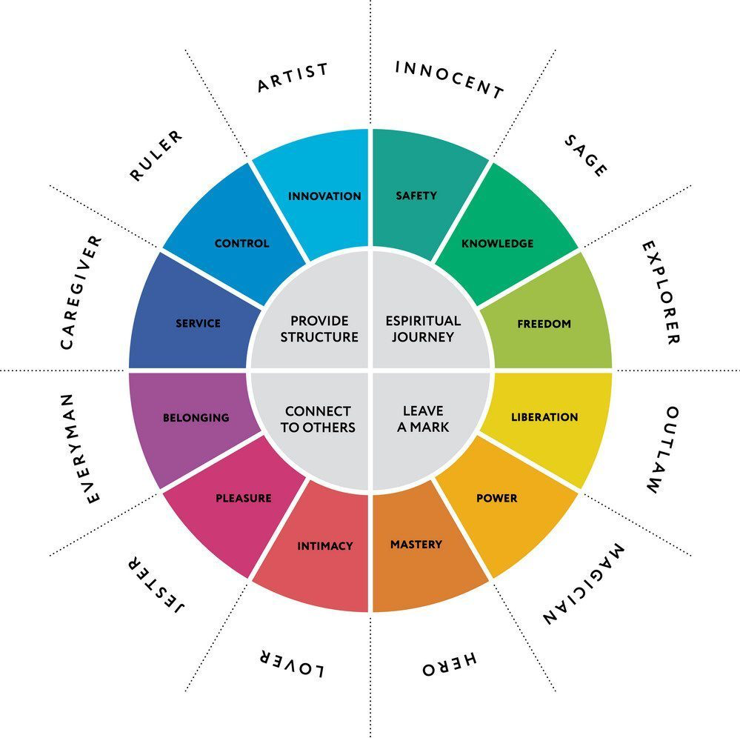












PERSONALITY
THE 12 COMMON ARCHETYPES
The psychologist, Carl Gustav Jung, used the concept of archetypes in his theory of the human psyche. He believed that universal, mythic characters—archetypes—reside within the collective unconscious of people the world over. Archetypes represent fundamental human motifs of our experiences as we evolved; consequently, they evoke deep emotions.
Although there are many different archetypes, Jung defined twelve primary types that symbolize basic human motivations. Each type has its own set of values, meanings, and personality traits.
REBEL
SOURCE: https://conorneill.com/2018/04/21/understanding-personality-the-12-jungian-archetypes/

Slide 30
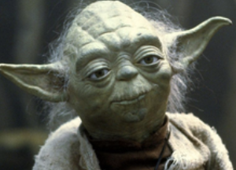
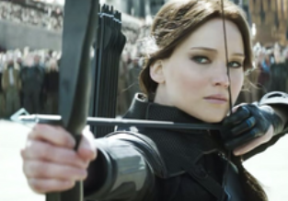
PERSONALITY
CONFIDENCE
OUTCOME
FREEDOM
The emotional outcome
when we deliver on our
Brand Promise
Strategic Legal Counsel For Entrepreneurs
Equinox the playing field with the
mega corps
THE SAGE ARCHETYPE
Motto: The truth will set you free
Core desire: to find the truth.
Goal: to use intelligence and analysis to understand the world.
Biggest fear: being duped, misled—or ignorance.
Strategy: seeking out information and knowledge; self-reflection and understanding thought processes.
Weakness: can study details forever and never act.
Talent: wisdom, intelligence.
The Sage is also known as: The expert, scholar, detective, advisor, thinker, philosopher, academic, researcher, thinker, planner, professional, mentor, teacher, contemplative.
THE REBEL ARCHETYPE
Motto: Rules are made to be broken
Core desire: revenge or revolution
Goal: to overturn what isn’t working
Greatest fear: to be powerless or ineffectual
Strategy: disrupt, destroy, or shock
Weakness: crossing over to the dark side, crime
Talent: outrageousness, radical freedom
The Rebel is also known as: The outlaw, revolutionary, wild man, the misfit, or iconoclast.
YODA
KATNISS EVERDEEN
SOURCE: https://conorneill.com/2018/04/21/understanding-personality-the-12-jungian-archetypes/

Slide 31

HERO ASSETS

Slide 32

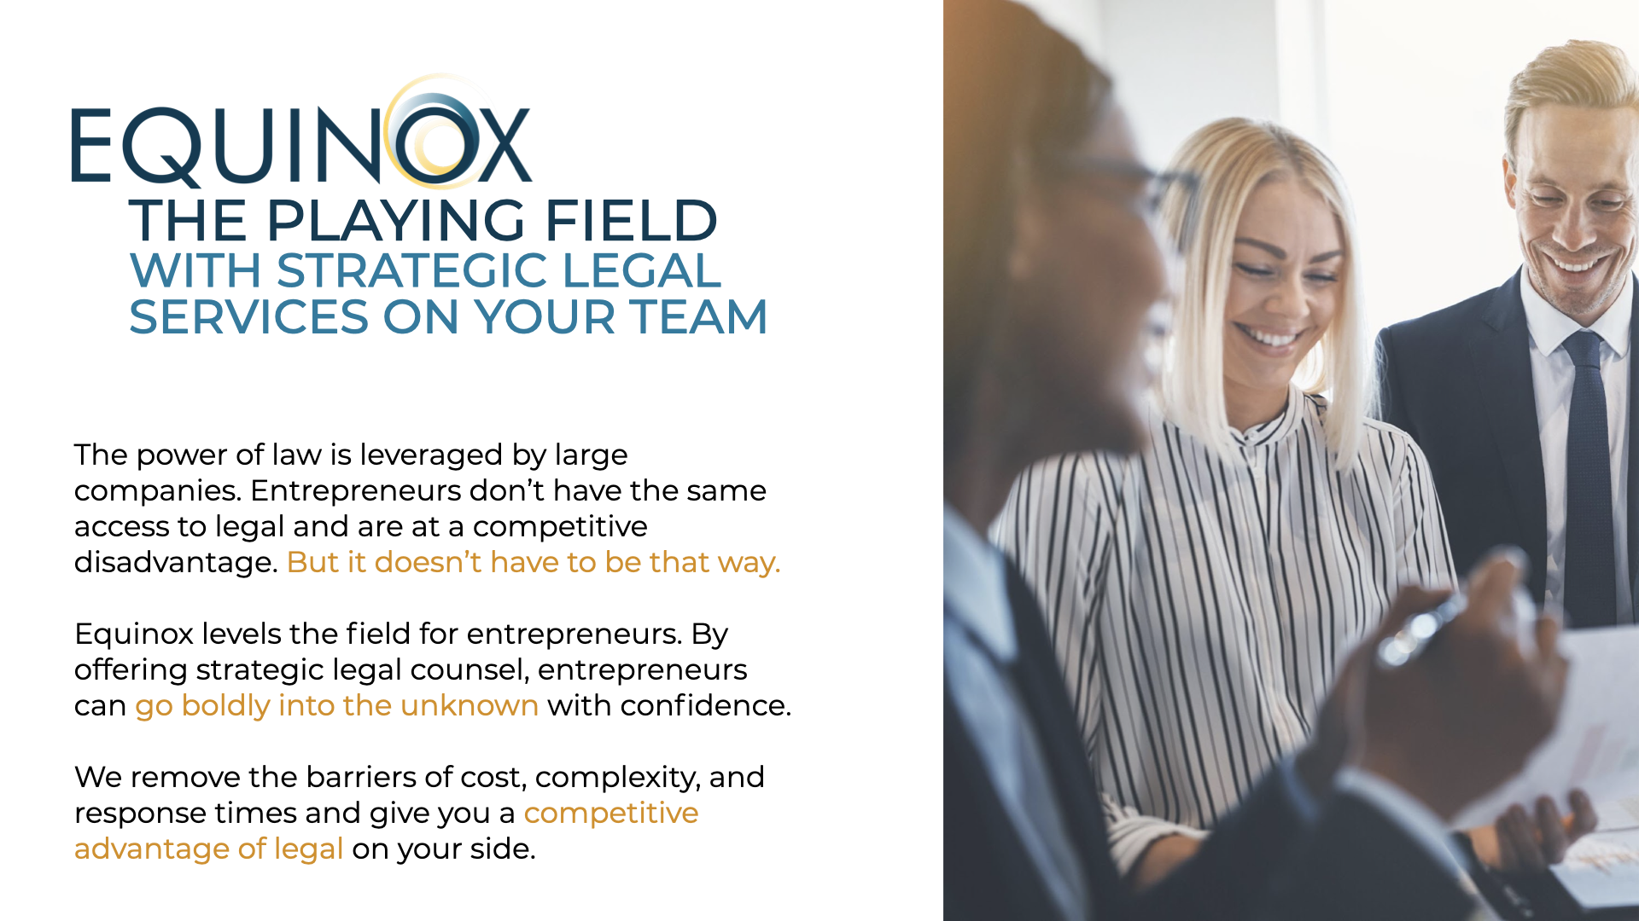
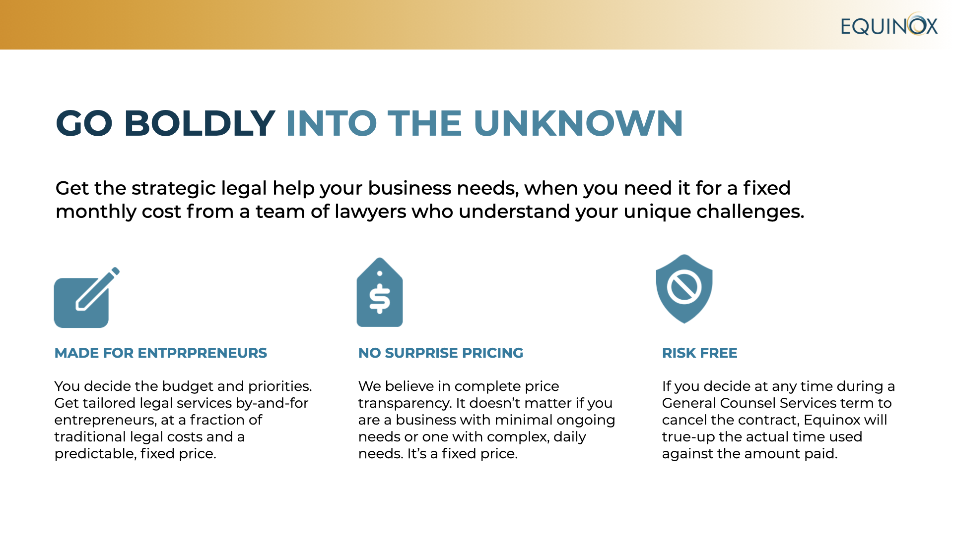
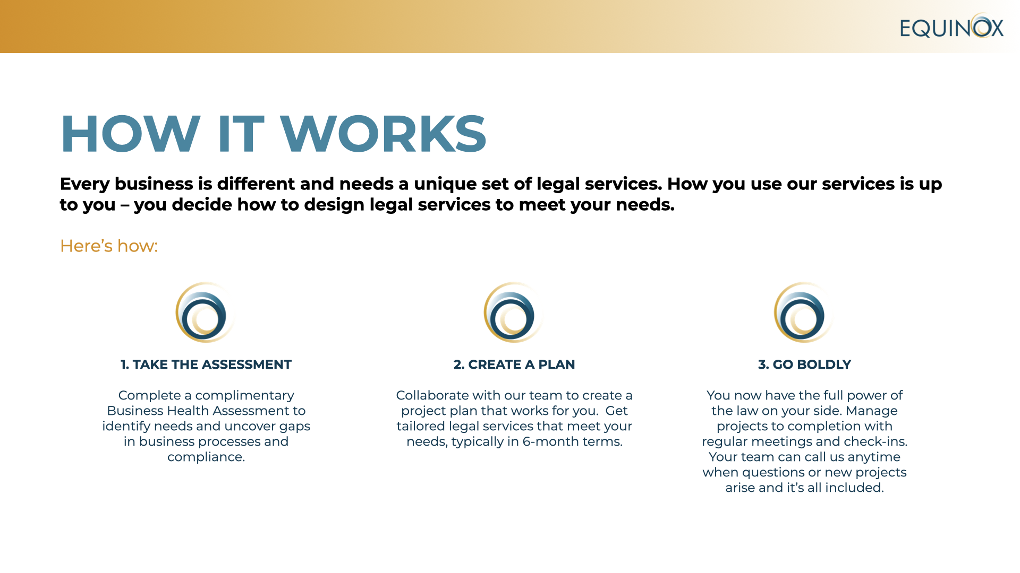
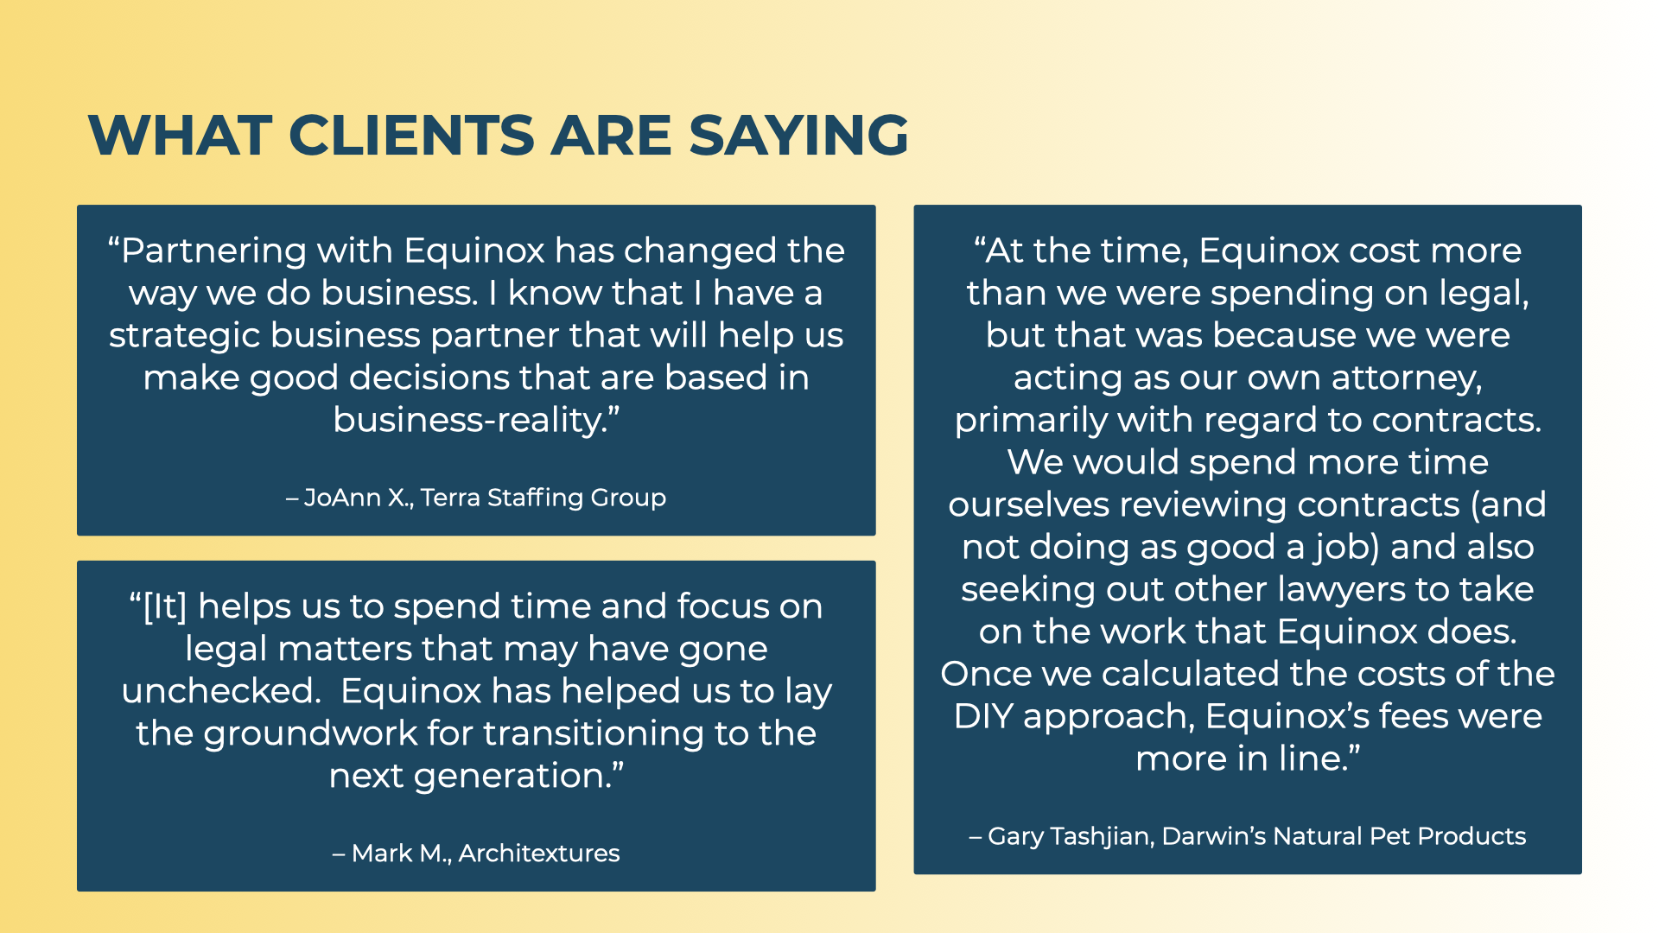
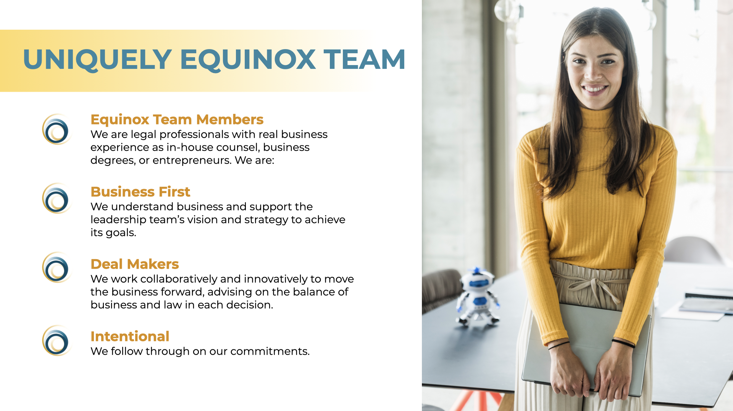
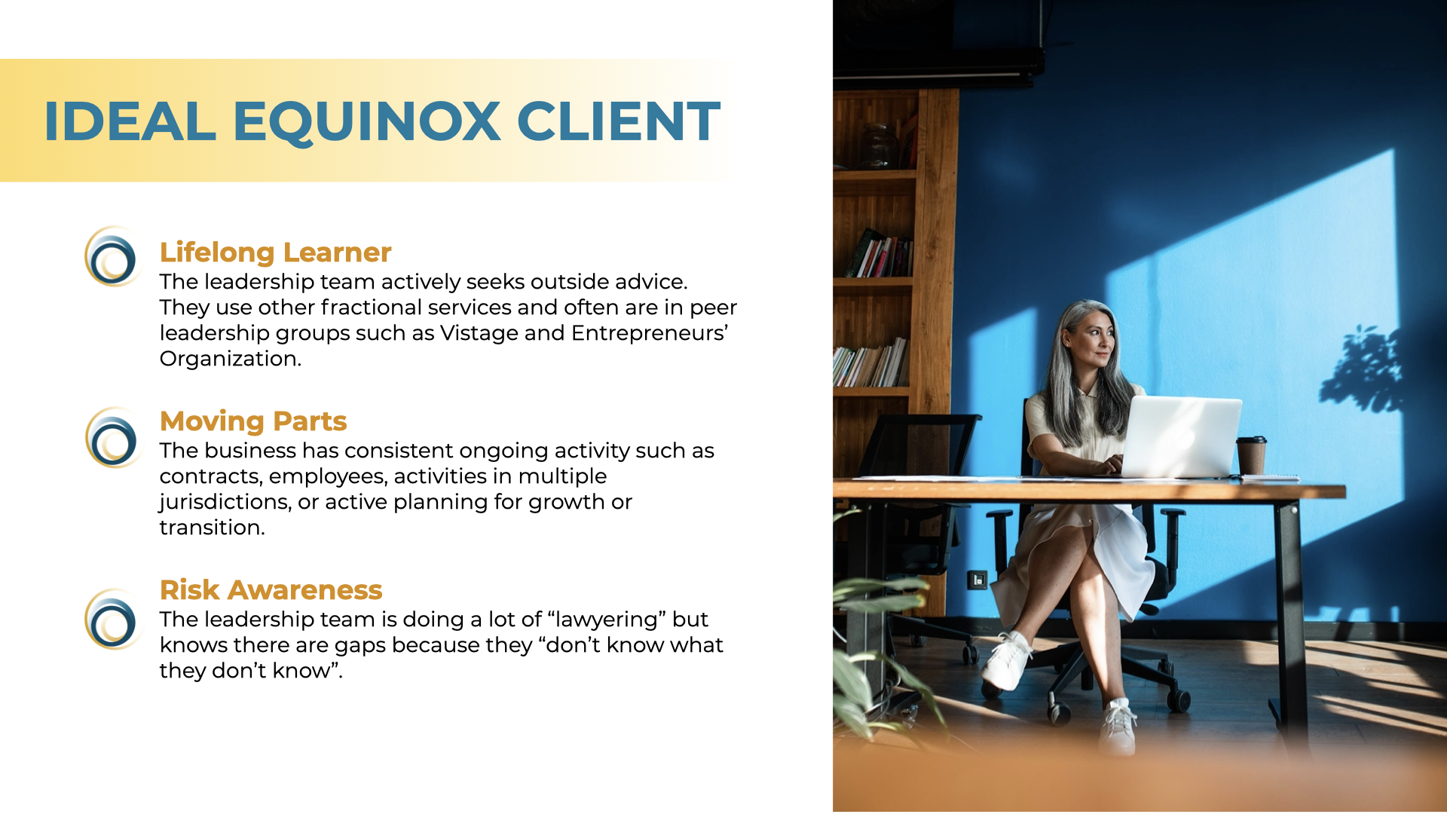
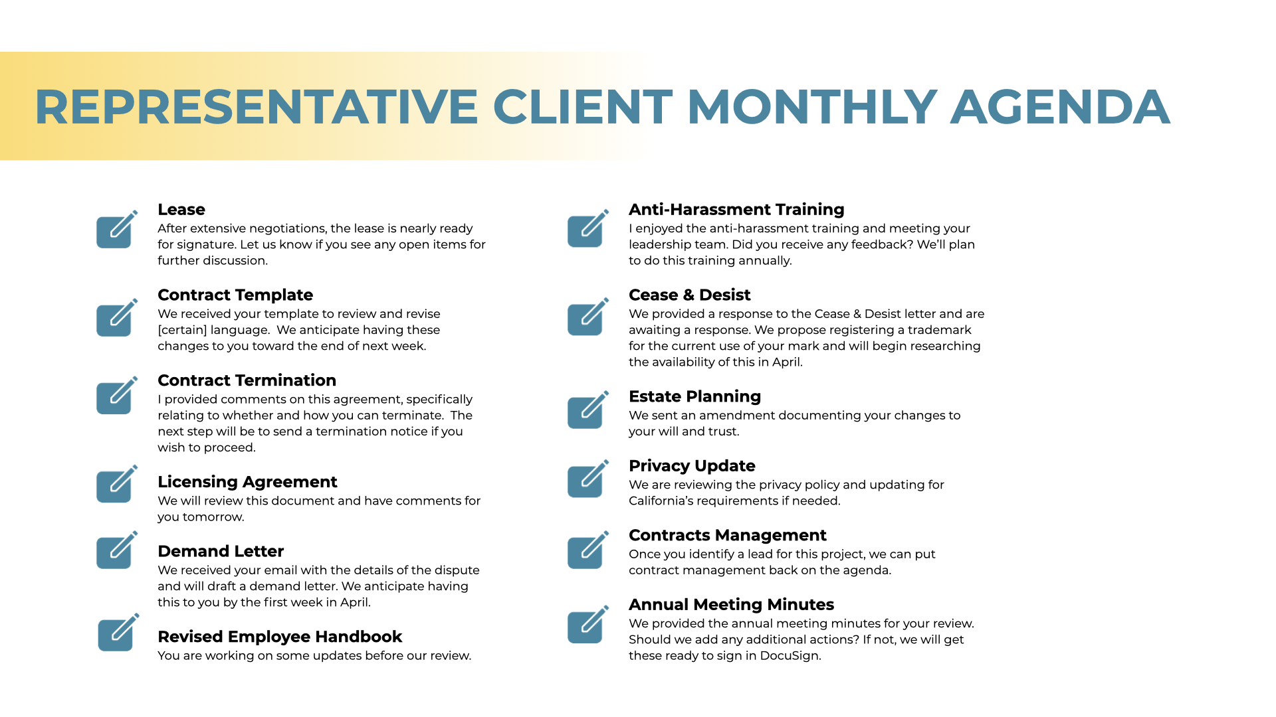

POWERPOINT/BROCHURE
LINK TO FILES

Slide 33
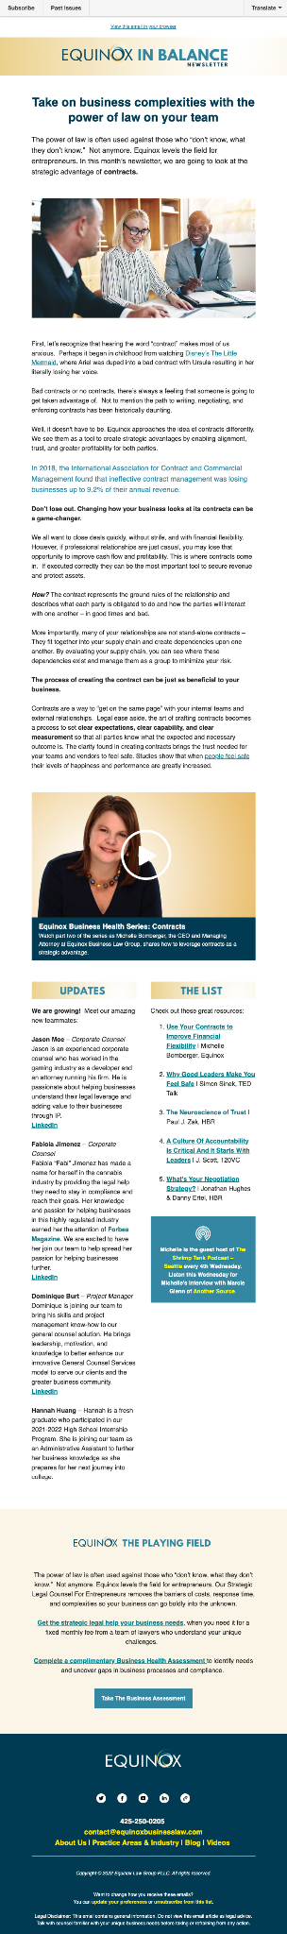
EMAIL / IN BALANCE NEWSLETTER
LINK TO FILES

Slide 34
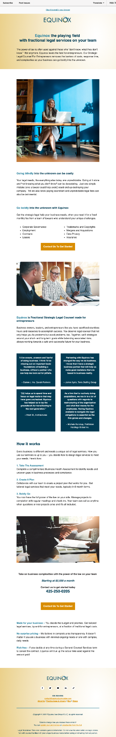
EMAIL / MARKETING
LINK TO FILES

Slide 35
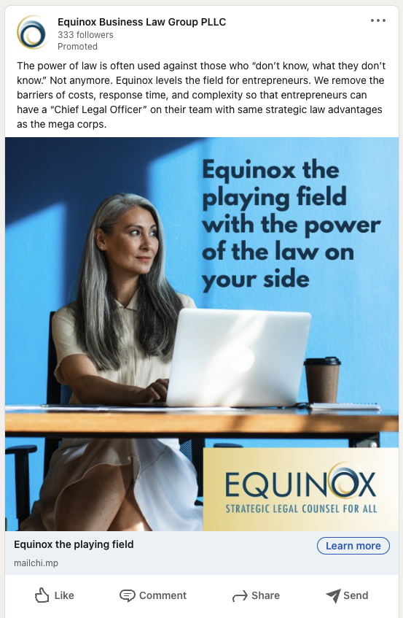








ADS

Slide 36

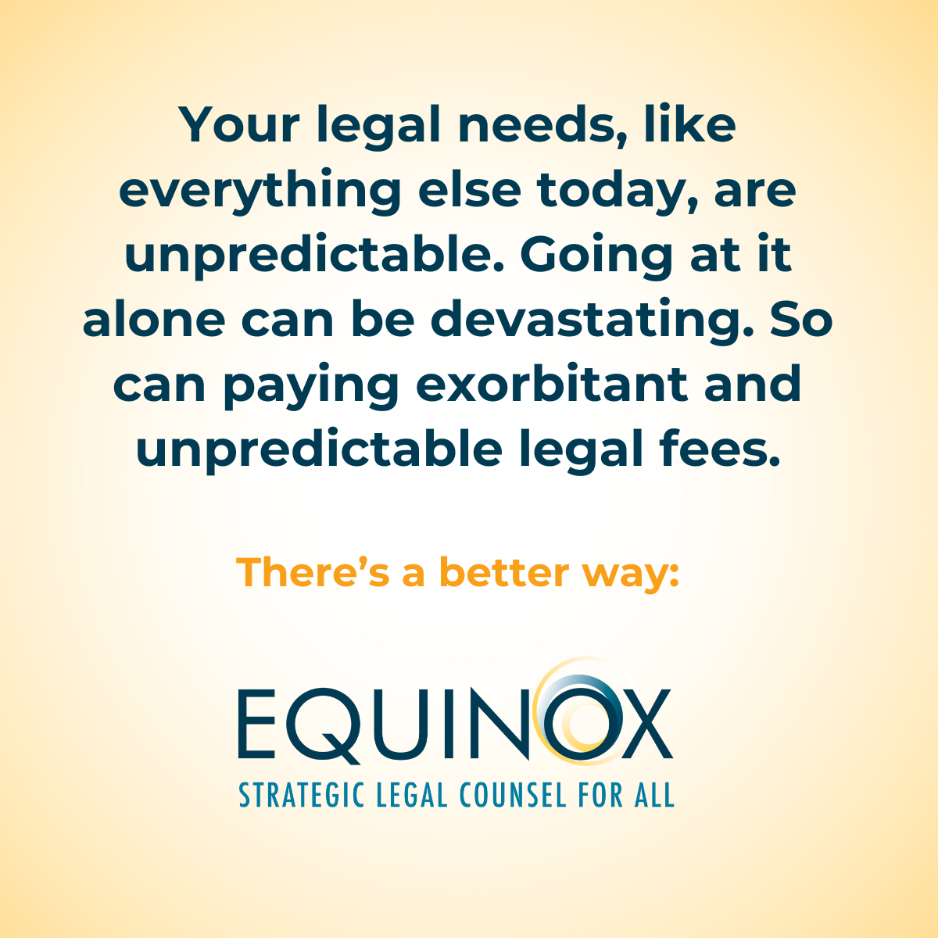

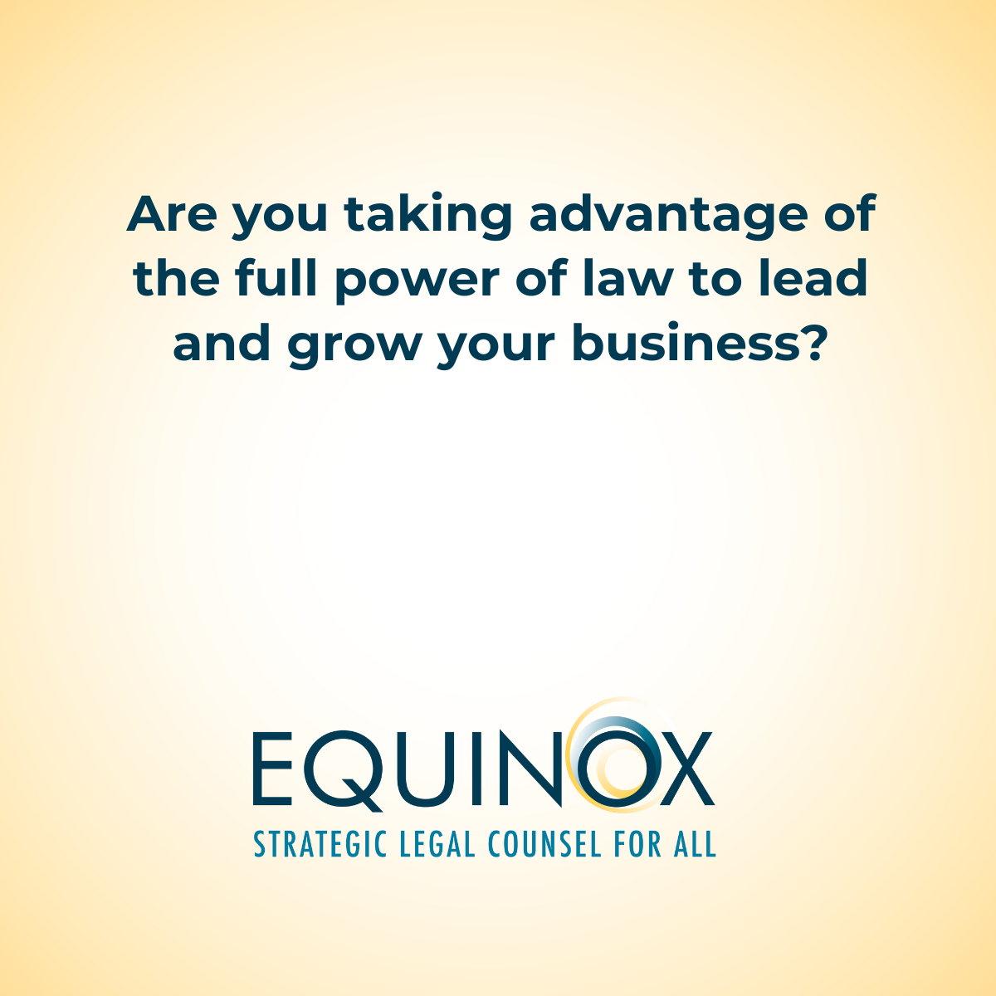
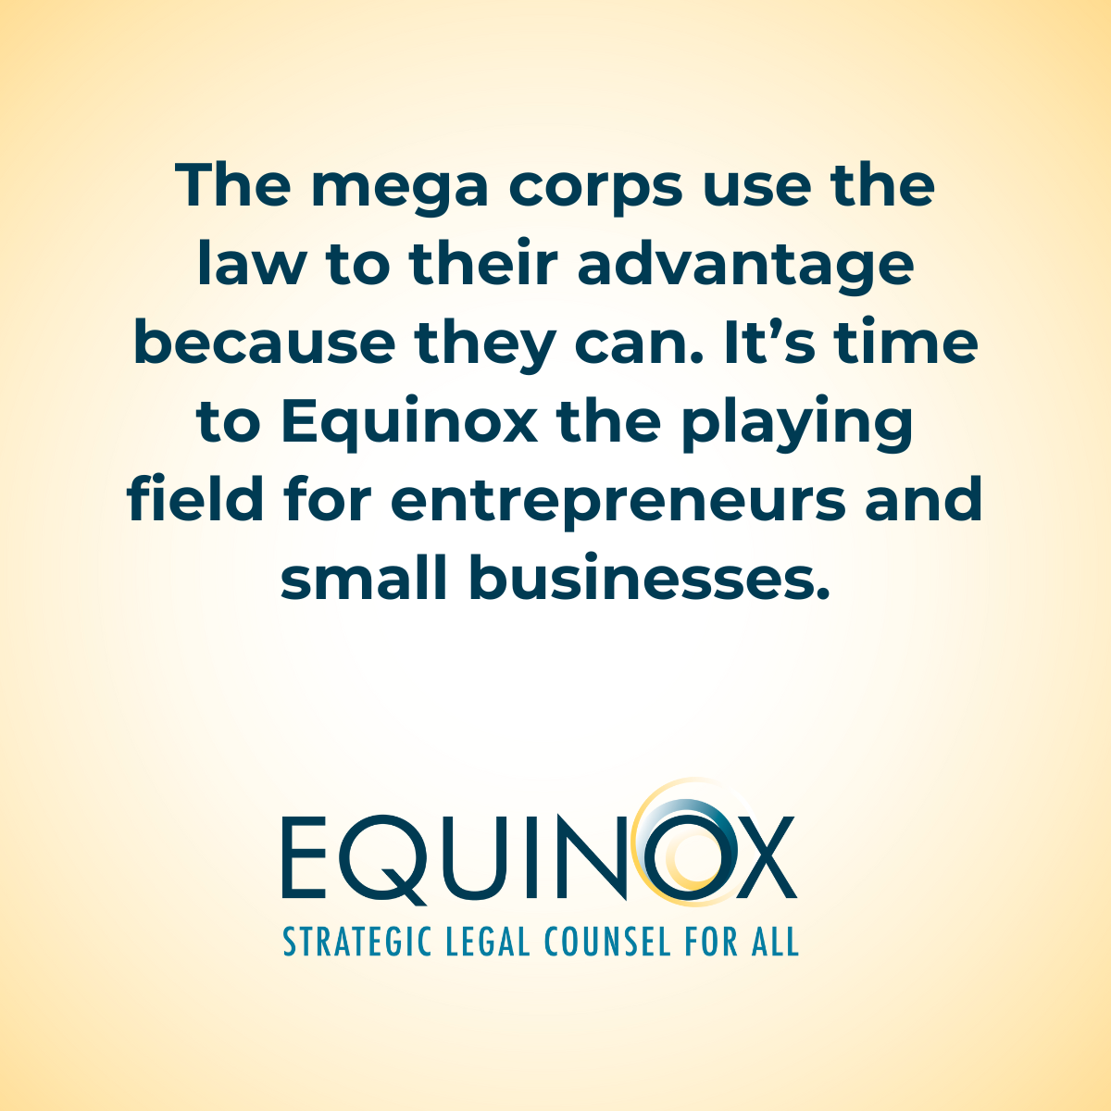

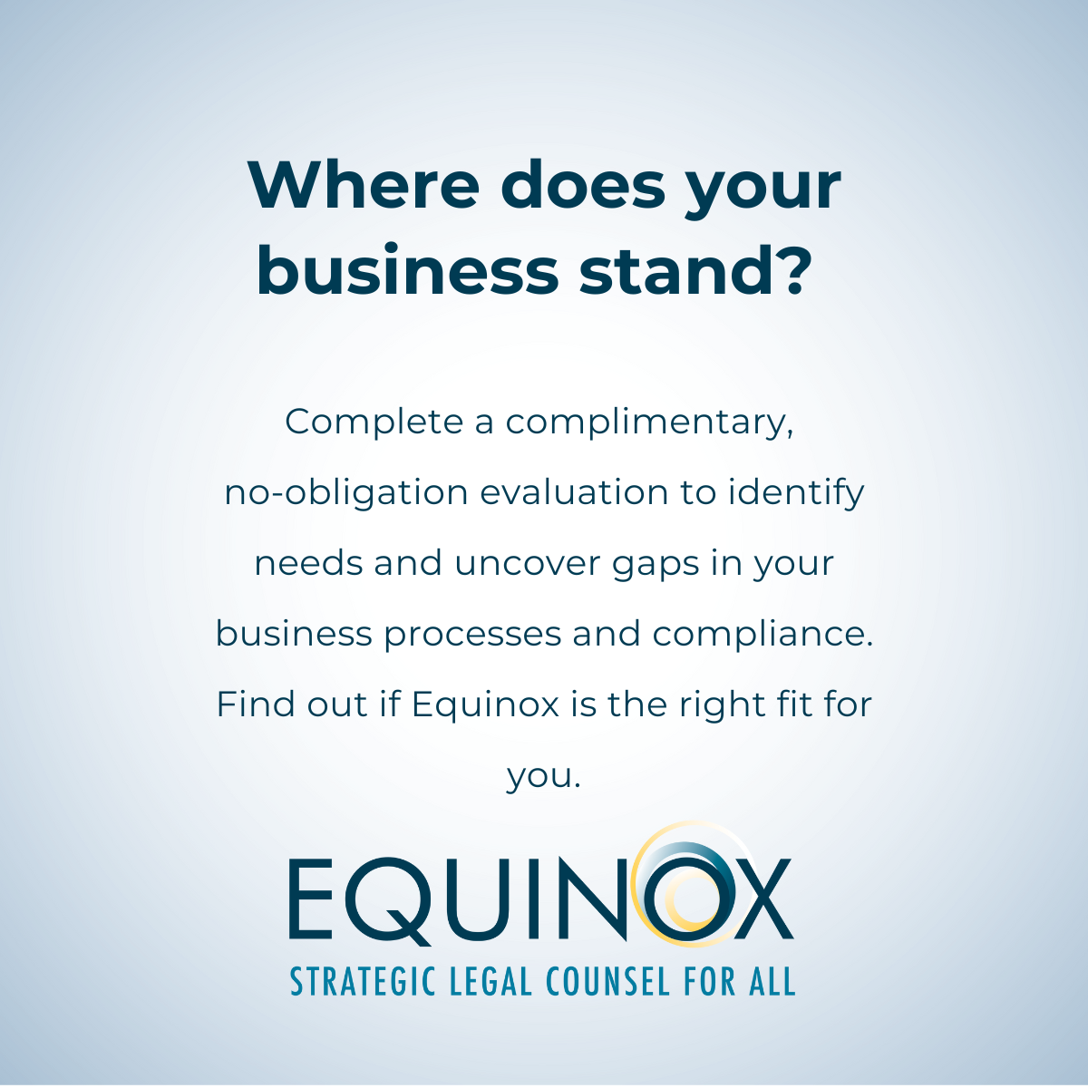

SOCIAL MEDIA
LINK TO FILES

Slide 37



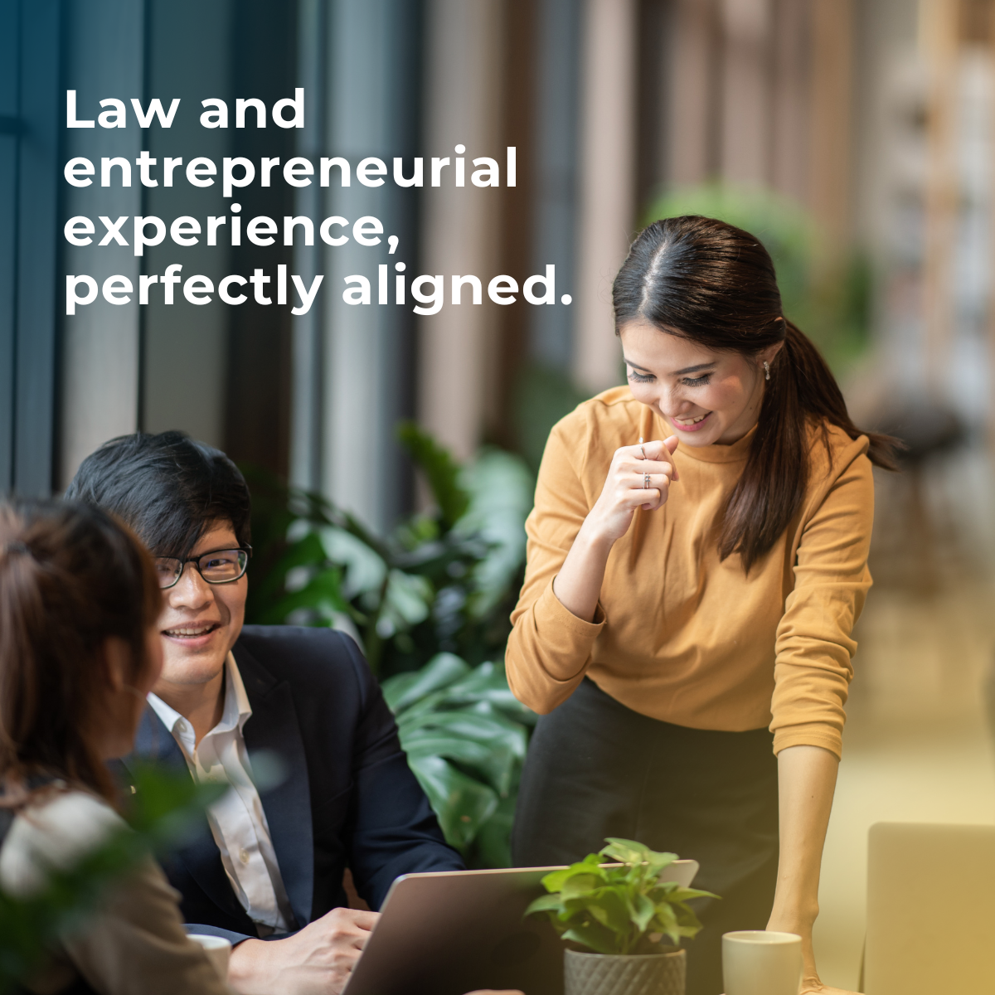

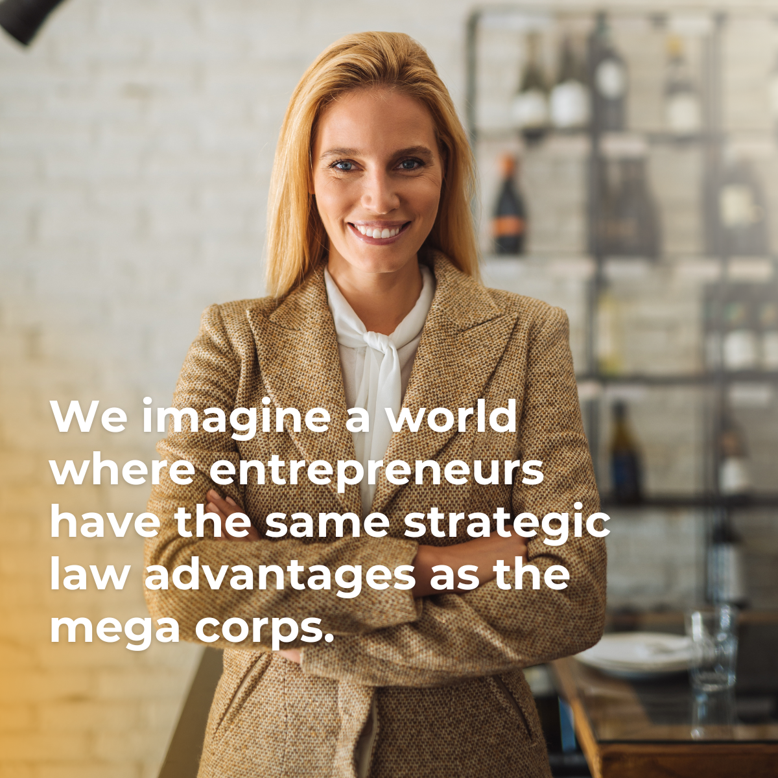


SOCIAL MEDIA
LINK TO FILES

Slide 38
WEBSITE
LINK TO WEBSITE

Slide 39








ADS / GOOGLE DYNAMIC
LINK TO FILES
Description 1 | Description 2 | Description 3 | Description 4 | Long headline | Headline 1 | Headline 2 | Headline 3 | Headline 4
Get the confidence of legal on your team, with fixed cost Business General Counsel Solutions. | General Counsel Solutions freeing you up to get back to what you do best. | General Counsel Solutions for small businesses at a monthly fixed-cost. |  | Discover Law The Way it Should Be! General Counsel Solutions | Business Law Group | Take The FREE Assessment | Law The Way It Should Be | General Counsel Solutions
Go boldly into the unknown with a fractional Chief Legal Officer on your team. | Law and entrepreneurial expertise, perfectly aligned. Giving you a strategic advantage. | Fractional, Executive Legal by-and-for entrepreneurs at monthly fixed cost. | Entrepreneur legal help your company needs, when it needs it, all for a fixed monthly fee. | Get the same strategic law advantages as the mega corps. | Entrepreneur Law Group | Hire On-Demand Legal Services | Go Boldly Into The Unknown | Fractional In-house Counsel
Go boldly (and legally) into the unknown with a Factional Chief Legal Officer on your team. | Add “Chief Legal Officer” to your team, at fraction of the cost. | Fractional, Executive Legal Counsel giving strategic advantage to entrepreneurs. | Don't go at it alone. Hire a fractional general counsel, at monthly fixed cost. | Law and entrepreneurial expertise, perfectly aligned. | The Entrepreneur's Legal Team | Hire Fractional Legal Counsel | Law And Business Aligned | Fractional Legal Services
Know what you don't know. Bring on Fractional, Executive Legal Counsel at a fixed cost. | Fixed-cost legal. Give your business the same strategic law advantages as the mega corps. | Take on business complexities with Fractional, Executive Legal Counsel at a fixed fee. | Fractional general counsel provides the legal help your company needs, when it needs it, all for a fixed monthly fee. | Level the playing field. Fixed-Cost Legal Services for Entrepreneurs. | Strategic Legal Counsel | Learn About Fractional Legal | Equinox The Playing Field | Fixed-Cost Legal Services

Slide 40

BRAND BRICKS
Great brands are built brick by brick. Like a Lego set, our brand architecture is designed as a modular system and story and design pieces that can be quickly assembled for a variety of expressions and situations.

Slide 41



Slide 42



BLUE GRADIENTS
STRATEGIC ADVANTAGE
Get the same strategic advantage as the mega corps.
YELLOW GRADIENTS
POWER OF LAW
Equinox enables entrepreneurs to go boldly into the unknown with the full power of law in their corner.
PEOPLE PHOTOGRAPHY
GROWTH MINDSET
Entrepreneur leaders with a growth mindset who leverage fractional services for expertise and growth, but not for legal.
ICON LOGO
PERFECTLY ALIGNED
Law and entrepreneurial experience, perfectly aligned.
WORDMARK
BOLDLY GO
Enter Equinox Business Law Group, a team of Entrepreneurs who are also attorneys on a mission to enable all business leaders to go boldly into the unknown.

Slide 43

STORY BRICKS

Slide 44

BRAND NARRATIVE
Copy for use in introductory, brand storytelling. Ex. website, social media, company profile listings.
ONE LINE
ONE PAGE
Go boldly into the unknown with Equinox Strategic Legal Counsel on your side.
Entrepreneurs exist to challenge the status quo. The power of law exists to level the playing field, but is often used against those who “don’t know, what they don’t know.”
Enter Equinox, a team of Entrepreneurs who are also attorneys on a mission to enable all business leaders to go boldly into the unknown.
We remove the barriers of costs, response time, and complexity so that every business can have a “Chief Legal Officer” on their team, giving them the same strategic law advantages as the mega corps.
The Equinox Strategic General Counsel model provides you with a team of business-minded attorneys at a fixed monthly cost. So you can get the help you need when you need it.
ONE SENTENCE
Equinox the playing field with Strategic Legal Counsel on your team.
ONE PARAGRAPH
The power of law is often used against those who “don’t know, what they don’t know.” Not anymore. Equinox levels the field for entrepreneurs. Our Strategic Legal Counsel For Entrepreneurs removes the barriers of costs, response time, and complexities so your business can go boldly into the unknown.

Slide 45
PRODUCT/SERVICE NAMES & DESCRIPTIONS
Copy for use in defining the services and products we offer.
Ex. internal onboarding, website, email, industry listings, etc.
NAMES
DESCRIPTION
Strategic Legal Counsel For Entrepreneurs
Just as you may tap into a managed services provider (MSP) for HR, accounting or IT to expand your capabilities without adding to your headcount, you can also tap into the power of law with Equinox.
Our fixed monthly cost, managed services (MSP) approach removes the barriers of costs, response time, and complexity so that every business can have the same strategic law advantages as the mega corps.
Unlike the mega attorneys, we bring a balance of strategic business and legal guidance. You set the priorities and the budget. Our team builds a personalized plan at a fixed monthly cost to best serve your legal priorities and needs.
Strategic Legal Counsel For Entrepreneurs (short)
Equinox the playing field with our fixed monthly cost, managed services (MSP) approach that removes the barriers of costs, response time, and complexity so that every business can have the same strategic law advantages as the mega corps.

Slide 46
PRODUCT/SERVICE NAMES & DESCRIPTIONS
Copy for use in defining the services and products we offer.
Ex. internal onboarding, website, email, industry listings, etc.
NAMES
DESCRIPTION
Business Health Assessment (Survey)
A complimentary, no-obligation evaluation to identify needs and uncover gaps in your business processes and compliance. It’s an quick way to determine where your business stands, and if Equinox is the right fit for you.
Business Health Consult (Meeting)
A complimentary, one-on-one discussion with an experienced business lawyer to talk through areas of concern, strength, and risk. The meeting is extremely personalized, tailored to your business’s individual needs, challenges you may be facing, projects on the back burner, and any areas of your business that need more focused attention. Within a week, you’ll get a customized summary of recommendations based on your Business Health Assessment.
Business Health Workshop (Class)
Learn what you need to reach and maintain a healthy business fit for leading a business through today’s uncertain and always changing environment. This self-guided, six-part workshop includes attorney led video trainings and tools to evaluate the current state of your business’s corporate strategy, compliance, human resources, financial planning, exit planning, and property protection.

Slide 47
PRODUCT/SERVICE NAMES & DESCRIPTIONS
Copy for use in defining the services and products we offer.
Ex. internal onboarding, website, email, industry listings, etc.
NAMES
DESCRIPTION
In Balance Newsletter
A monthly email publication from Equinox that’s equal parts law and business–covering the issues that matter to entrepreneurs in Washington.
Equinox Legal Update
An email alert from Equinox on new or changing state and federal and laws that affect entrepreneurs in Washington. Updates are included in every client plan.

Slide 48
PRODUCT/SERVICE NARRATIVE
Copy for use in communicating categorically how we help to new clients. Ex. website, emails, brochure, etc.
PROBLEM
SOLUTION
Going blindly into the unknown can be costly
Your legal needs, like everything else today, are unpredictable. Going at it alone and “not knowing what you don’t know” can be devastating. Just one simple mistake (one a lawyer could help avoid) could end up destroying your company. Yet we also know paying exorbitant and unpredictable legal fees can also be detrimental.
Go boldly into the unknown with the full power of law in your corner.
Our fixed-cost, Strategic Legal Counsel removes the barriers of costs, response time, and complexity so that every business can have a “Chief Legal Officer” on the team, giving them the same strategic law advantages as the mega corps.
Equinox is law and entrepreneurial experience, perfectly aligned.
Business owners, leaders, and entrepreneurs like you have sacrificed countless hours and resources to accomplish success. You deserve legal counsel that not only helps you fix problems but avoid problems, too. Together, we’ll strategize around your short- and long-term goals while balancing associated risks, always working towards a safe and successful future for your business.
Take on business complexities with confidence.
Get the strategic legal help your business needs, when you need it for a fixed monthly fee from a team of lawyers who understand your unique challenges.
Corporate Governance
Employment
Contracts
Leases
Trademarks and Copyrights
Mergers and Acquisitions
Data Privacy
Insurance

Slide 49
PITCH COPY
Copy for use in when we are introducing and pitching new clients. Ex. website, pitch decks, podcasts, emails, long social posts, etc.
HEADLINES
BODY
Equinox the playing field with Strategic Legal Counsel on your team.
Just as you may tap into a managed services provider (MSP) for HR, accounting or IT to expand your capabilities (without adding to your headcount), you can also tap into the power of law.
Never again hesitate in making crucial business decisions. With Equinox on your side, you have a team of strategic-minded, entrepreneur experienced attorneys who understand what it takes to lead and grow a successful business.
Unlike hiring a traditional business lawyer, with us there are no surprise legal fees, unexpected delays, or boilerplate solutions. You set the priorities and the budget. Our team builds a personalized plan at a fixed monthly cost to best serve your priorities and legal needs.
Contact us today 425-250-0205 to schedule a complementary Business Health Consult.
Or
Take our complementary, no-obligation Business Health Assessment to see where your business stands, and if Equinox is the right fit for you.
ATTRACT
ENGAGE
Go boldly* into the unknown (*and legally)
Are you taking advantage of the full power of law to lead and grow your business?
CONVERT

Slide 50
PITCH COPY
Copy for use in when we are introducing and pitching new clients. Ex. website, pitch decks, podcasts, emails, long social posts, etc.
HEADLINES
BODY
Get the same strategic advantage as the mega corps.
Starting at $2,500 a month
Made for your business – You decide the budget and priorities. Get tailored legal services by-and-for entrepreneurs, at a fraction of traditional legal costs.
No surprise pricing – We believe in complete price transparency. It doesn’t matter if you are a business with minimal ongoing needs or one with complex, daily needs.
Risk free – If you decide at any time during a General Counsel Services term to cancel the contract, Equinox will true-up the actual time used against the amount paid.
CONVERT

Slide 51
PRODUCT/SERVICE COPY
Copy for use in longformats where we have the audience’s attention. Ex. pitch decks, brochures, and website.
ONE PAGE: STRATEGIC LEGAL COUNSEL
Strategic Legal Counsel For Entrepreneurs
Just as you may tap into a managed services provider (MSP) for HR, accounting or IT to expand your capabilities (without adding to your headcount), you can also tap into the power of law with Equinox.
Our fixed monthly cost, managed services (MSP) approach removes the barriers of costs, response time, and complexity so that every business can have the same strategic law advantages as the mega corps. Unlike the mega attorneys, we bring a balance of strategic business and legal guidance tailored to the needs of entrepreneurs.
Corporate Governance
Employment
Contracts
Leases
Trademarks and Copyrights
Mergers and Acquisitions
Data Privacy
Insurance
How it works
Every business is different and needs a unique set of legal services. How you use our services is up to you – you decide how to design legal services to meet your needs.
Take the assessment
Complete a complimentary, no-obligation Business Health Assessment to identify needs and uncover gaps in business processes and compliance.
2. Create a plan
Schedule a complementary Business Health Consult with our team to collaborate and create a project plan that works for you. Get only the legal services that meet your needs, typically in 6-month terms.
3. Boldly go
You now have the full power of law on your side. Manage projects to completion with regular meetings and check-ins. Your team can call us anytime when questions or new projects arise and it’s all included.
What’s Included
Predictable, fixed costs tailored to the business needs and budget.
Unlimited communications to get a tailored strategic general legal counsel guidance for your entire team.
Responsive and empathetic help with 1-week turnaround on urgent projects, detailed project plan for the cycle
Thorough review of all business and industry annual requirements, advice on updates, and strategic guidance to set priorities, goals, tactics to achieve those goals, as well as any associated risks.
The investment
Equinox Strategic Legal Counsel plans start at $2,500 a month – No surprise fees – We believe in complete price transparency. You set the priorities and the budget. Our team builds a plan at a fixed cost to best serve your needs.

Slide 52
PRODUCT/SERVICE COPY
Copy for use in lead generation to qualify and capture leads.
Ex. email, landing pages, website.
ONE PAGE: BUSINESS HEALTH ASSESSMENT
Is your business at risk? Are you current with the ever-changing government regulations and laws? Are you leaving money on the table in negotiations and contracts?
See where your business stands today, take the Business Health Assessment
Just like getting an annual physical at your doctor, your business also deserves health checkups and proactive care. Our complementary, no obligation Business Health Assessment is a holistic review of your current business operations to address areas of concern and celebrate areas of strength. The assessment evaluates your business’s priorities, goals, tactics to achieve those goals, as well as any associated risks.
CTA: Take The Free Assessment
Find out if Equinox is the right fit for you, schedule a Business Health Consult
After completing this short assessment survey, we schedule a complementary, one-on-one discussion with an experienced business lawyer to talk through areas of concern, strength, and risk. The meeting is extremely personalized, tailored to your business’s individual needs, challenges you may be facing, projects on the back burner, and any areas of your business that need more focused attention. Within a week, you’ll get a customized summary of recommendations based on your Business Health Assessment.
CTA: Schedule A Business Health Consult
FAQ:
What is a Business Health Assessment?
A complimentary, no obligation evaluation to identify needs and uncover gaps in your business processes and compliance. It’s an quick way to determine where your business stands, and if Equinox is the right fit for you.
Why take a Business Health Assessment?
The sooner you’re able to evaluate the risk lurking in your business, the sooner you’re able to mitigate it. After the assessment, you’ll have a better understanding of what to look out for, along with actionable recommendations to mitigate risks specific to your goals.
What happens in a Business Health Clinic?
A complementary, one-on-one discussion with an experienced business lawyer to talk through areas of concern, strength, and risk. The meeting is extremely personalized, tailored to your business’s individual needs, challenges you may be facing, projects on the back burner, and any areas of your business that need more focused attention. Within a week, you’ll get a customized summary of recommendations based on your Business Health Assessment.
Is there a cost to taking a Business Health Assessment or participating in a Business Health Clinic?
We offer Business Health Assessments free of charge. Why? Because your business is our business, and your confidence in the current state of your business is an important step to growth, stability, and long-term success.
What areas are covered in the Business Health Assessment?
We’ll talk through the current state of your business’s corporate strategy, compliance, human resources, financial planning, exit planning, and property protection.

Slide 53
PRODUCT/SERVICE PITCH & CALL TO ACTION
Copy for use in short intro pitch descriptions. Ex. website, social media, industry listings.
PRODUCT
PITCH
CTA
Business Health Assessment
Where does your business stand? Complete a complimentary, no obligation evaluation to identify needs and uncover gaps in your business processes and compliance. Find out if Equinox is the right fit for you.
Take the assessment
In Balance Newsletter
Things are uncertain and always changing. Stay up to date with our monthly newsletter that’s equal parts law and business–covering the issues that matter to entrepreneurs in Washington.
Subscribe
Strategic Legal Counsel Plans
You now have the full power of law on your side. Manage projects to completion with regular meetings and check-ins. Your team can call us anytime when questions or new projects arise and it’s all included.
Go boldly into the unknown, contact us today

Slide 54
SOCIAL MEDIA
Copy for use in LinkedIn and Facebook organic and paid posts. Long body copy always to be placed in post not images.
FACEBOOK/LINKEDIN POSTS
Take on business complexities with the power of law on your team
The power of law is often used against those who “don’t know, what they don’t know.” Not anymore. Equinox levels the field for entrepreneurs. We remove the barriers of costs, response time, and complexity so that entrepreneurs can have a “Chief Legal Officer” on their team with same strategic law advantages as the mega corps.
CTA [link]: Add Strategic Legal Counsel to your team.
Law and entrepreneurial experience, perfectly aligned.
Like you, we are entrepreneurs. Unlike you, we are attorneys. We call ourselves Equinox because we serve our clients by bringing law and entrepreneurial expertise into perfect alignment. We remove the barriers of costs, response time, and complexities giving your business the freedom and confidence to go boldly into the unknown.
CTA [link]: Add Strategic Legal Counsel to your team.
Tired of surprise legal fees, unresponsive attorneys and boilerplate solutions?
Get the strategic legal help your business needs, when you need it for a fixed monthly cost from a team of lawyers who understand your unique challenges.
CTA [link]: Learn more about our fixed-cost Strategic Legal Counsel plans designed for Entrepreneurs.
Go boldly* into the unknown (*and legally)
Never again hesitate in making crucial business decisions. With Equinox on your side, you have a team of strategic-minded, experienced entrepreneur attorneys who understand what it takes to lead and grow a successful business.
CTA [link]: See how Strategic Legal Counsel can help your business.

Slide 55
SOCIAL MEDIA
Copy for use in LinkedIn and Facebook organic and paid posts. Long body copy always to be placed in post not images.
FACEBOOK/LINKEDIN POSTS
Add the power of law to your team, at a fraction of traditional legal cost.
Just as you may tap into a managed services provider (MSP) for HR, accounting or IT to expand your capabilities (without adding to your headcount), you can also tap into the power of law.
Introducing a new managed services approach to law with a fixed monthly cost, that makes it possible for every business can have the same strategic law advantages as the mega corps.
CTA [link]: See how Strategic Legal Counsel can help your business.
Is your business at risk?
Are you current with changing government laws?
Are you leaving money in contract negotiations?
Find out where your business stands. Complete a complimentary, no obligation evaluation to identify needs and uncover gaps in your business processes and compliance.
CTA [link]: Take our complimentary Business Health Assessment
Mega corps aren’t the only ones with an army of attorneys.
Equinox the playing field with the full power of law on your side. Get the strategic legal help your business needs at a fixed monthly cost so you can lead your business boldly into the unknown.
CTA [link]: Meet your army of attorneys.
We imagine a world where entrepreneurs have the same strategic law advantages as the mega corps.
That’s why we do everything in our power to remove the barriers of costs, response time, and complexity to make it possible for all business leaders to have a “Chief Legal Officer” on their team.
CTA [link]: Learn more about how our fixed cost, Strategic Legal Counsel is leveling the playing field.

Slide 56

SOCIAL MEDIA
Copy for use on twitter adding links and hashtags as necessary. Minimal use of emojis.
TWEETS
Equinox the playing field with Strategic Legal Counsel on your team. [link]
Take on business complexities with the power of law on your team. Strategic Legal Counsel For Entrepreneurs [link]
Law and entrepreneurial experience, perfectly aligned. Get the strategic legal help your business needs, when you need it for a fixed monthly cost from a team of lawyers who understand your unique challenges. [link]
We remove the barriers of 💰, response ⏰, and 🧠 so that every business can have the same strategic law advantages as the mega corps. [link]
Go boldly* into the unknown (*and legally) [link]
With Equinox on your side, you have a team of strategic-minded attorneys who understand what it takes to lead and grow a successful business. [link]
Never again hesitate in making the decisions needed to grow and protect your business and your people. [link]
Equinox the playing field with our fixed monthly cost, managed services approach that enables every business can have the same strategic law advantages as the mega corps. [link]
Find out if Equinox is the right fit for your business. Take our complimentary Business Health Assessment [link]
Learn more about how our fixed cost, Strategic Legal Counsel is leveling the playing field. [link]
Meet your army of attorneys waiting in the wings. Equinox the playing field [link]
The mega corps use law to their advantage because they can. It’s time to Equinox the playing field for entrepreneurs and small businesses. [link]
As entrepreneurs ourselves, we get it. There’s no room for second guessing. No margin for errors or overspending. Every dollar and every minute matters. We are here to help. [link]
Your legal needs, like everything else today, are unpredictable. Going at it alone can be devastating. So can paying exorbitant and unpredictable legal fees. There’s a better way: [link]

Slide 57
DESIGN BRICKS

Slide 58
LOGO
CONCEPT
Our logo represents our brand promise law and entrepreneurial experience, perfectly aligned.
The “swirl” of day and night becoming one together is how we become one team with our clients with equal parts law and business.
Balance and equity is in our namesake: the “equinox”, time (twice each year) when day and night are of approximately equal length as the sun crosses the celestial equator (about September 22 and March 20).
In use, our logo shows up with and without the tagline. It should be on white or bright brand gradient backgrounds to best convey the bold confidence we empower.

Slide 59

LOGO
LINK TO FILES
WORDMARK
WORDMARK WITH TAGLINE

Slide 60
LOGO
LINK TO FILES
WORDMARK REVERSE
WORDMARK WITH TAGLINE REVERSE

Slide 61
LOGO
LINK TO FILES
SWIRL MARK
SWIRL MARK REVERSE

Slide 62
COLOR
CONCEPT
Our colors are designed to convey the feeling of confidence and freedom that result from brand’s promise of law and entrepreneurial experience, perfectly aligned.
We use of color in alignment and in contrast to represent our alignment of law and business as well as the alignment as one team with our clients.
We use gradients to show the two colors becoming one.
BRIGHT YELLOW = LAW
BRIGHT BLUE = BUSINESS
YELLOW = CONFIDENCE
BLUE = FREEDOM
DARK YELLOW = DAY
DARK BLUE = NIGHT

Slide 63
LINK TO FILES
COLORS
DAY
CONFIDENCE
LAW
NIGHT
BUSINESS
FREEDOM
HEX
RGB
HSB
CMYK
LAB
PANTONE
#D98D00
217, 141, 0
39, 100, 85
0, 35, 100, 15
65, 20, 70
131 C
HEX
RGB
HSB
CMYK
LAB
PANTONE
#FFD457
255, 212, 87
0, 0, 73
0, 17, 66, 0
87, 2, 65
135 C
HEX
RGB
HSB
CMYK
LAB
PANTONE
#FFFAEB
255, 250, 235
45, 8, 100
0, 2, 8, 0
98, -1, 8
155 C
HEX
RGB
HSB
CMYK
LAB
PANTONE
#003b53ff
0, 59, 83
197, 100, 33
100, 29, 0, 67
23, -7, -19
540 C
HEX
RGB
HSB
CMYK
LAB
PANTONE
#027CA1
2, 124, 161
194, 99, 63
99, 23. 0, 37
48, -15, -28
7704 C
HEX
RGB
HSB
CMYK
LAB
PANTONE
#93BCCD
147, 188, 205
198, 28, 80
28, 8, 0, 20
74, -10, -13
283 C

Slide 64
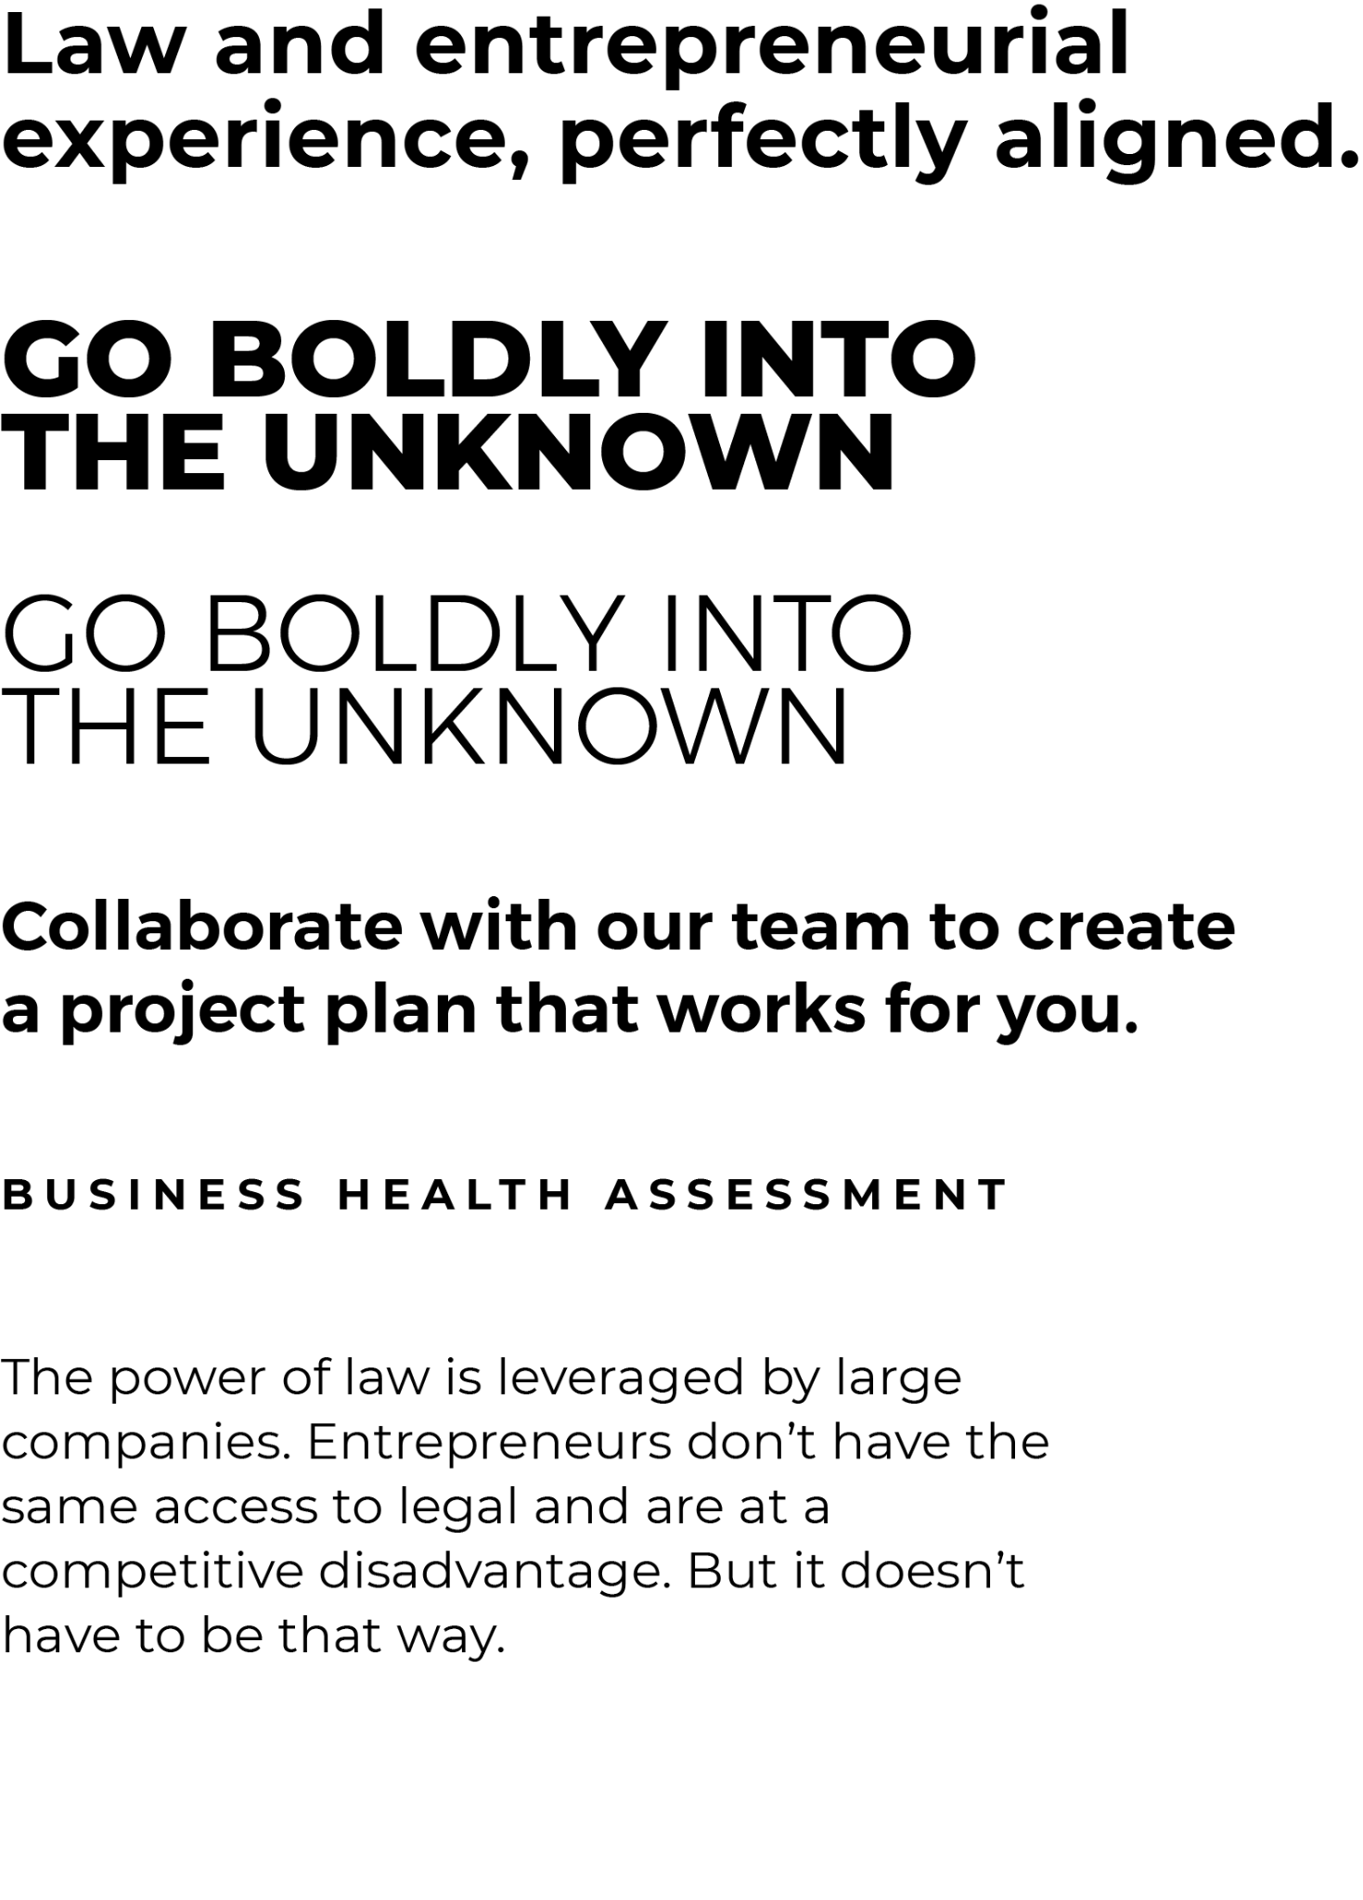
FONTS
LINK TO FILES
HEADLINES H1
Montserrat Bold
Sentence Case
Line Height 1.1
Tracking +5
HEADLINES SHORT H2
Montserrat ExtraBold
All Caps
Line Height .08
Tracking 0
HEADLINES SHORT H3
Montserrat Light
All Caps
Line Height .08
Tracking 0
SUB HEADLINES H4
Montserrat SemiBold
Sentence Case
Line Height 1.3
Tracking +5
CALLOUTS
Montserrat Bold
All Caps
Line Height 1
Tracking +250
BODY
Montserrat Regular
Sentence Case
Line Height 1.2
Tracking +5

Slide 65













ICONS
LINK TO FILES

Slide 66

TEAM PHOTOGRAPHY
LINK TO FILES

Slide 67
PHOTOGRAPHY
LINK TO FILES
Entrepreneurs At Work
Entrepreneur Profiles
Diverse people in their place of business
Small business, not large corporate
Bright, natural lighting with flares or glows
People not looking at camera
Bold and confidently working
Warm tone, cinematic shallow depth of field
Diverse people in their place of business
Bold and confident pose, looking at camera
Small business, not large corporate
Bright, natural lighting with flares or glows
Warm tone, cinematic shallow depth of field

Slide 68
PHOTOGRAPHY
LINK TO FILES
Collaboration
Diverse groups of people representing Equinox and Clients together as one team
Wardrobe has pops of brand colors
Small business, not large corporate setting, minimal as possible
Bright, natural lighting with flares or glows
People not looking at camera
Bold and confidently working
Warm tone, cinematic shallow depth of field

Slide 69
PHOTOGRAPHY LIBRARY
LINK TO FILES
Envato Stock
Upsplash Stock

Slide 70
BLUE PRINTS

Slide 71
MARKETING FUNNEL
Attract
Create awareness and relevancy. Paid ads and content placements while customers are in the mindset of building their business–hiring managed services for HR, IT, Accounting, etc.
Engage
Offer value as “guide” with free content that helps customers go boldly. This can be BHA as a product, the newsletter as a resource, videos trainings as introduction to Equinox as guide.
Convert
Call to action: take the assessment, book an appointment, sign up for an event or a training.
Ads: Google Search & Display, Youtube & Linkedin Videos
Adjacencies: Listings, Affiliate Marketing & Events
Webpage: Blog & Video Content
Subscribe: Newsletter, Classes, Videos
Engage: Assessment
Convert: Appointment Booking

Slide 72
MAP
EDITORIAL
& PR
SPONSORS
(Lists and Publications)
EVENTS
(Webinars, Podcast Appearances, etc.)
SEO
(Organic & Paid Search)
PAID MEDIA
(Google Display and Search, LinkedIn & Facebook, YouTube Ads)
BLOG
WEBSITE
SOCIAL MEDIA
(Organic LinkedIn)
VIDEO
(Training YouTube)
EMAIL
(Newsletter)
CLIENT PORTAL
PDF
(EBooks)
EMAIL
(Drips)

Slide 73
SOCIAL MEDIA

Slide 74
EMAIL

Slide 75
BHA

Slide 76
WEBSITE

Slide 77
THX

